Slide 1

GROUP 29
Multimodal AI Framework for Social Media Based Mental Disorder Detection and Personalized Wellbeing Insights
ROLL NUMBER | NAME
13000121033 | SOUMYADEEP NANDY
13000121037 | PRITHWISH SARKAR
13000121040 | SAGNIK MUKHOPADHYAY
13000121058 | ARKAPRATIM GHOSH
PROJECT-III ( PROJ-CS881 ) [ UPID : 8295 ]
CSE : SEMESTER 8
JUNE 2025
@DEPT. OF CSE, TMSL

Slide 2

CONTENT
GR29 MULTIMODAL AI FRAMEWORK FOR SOCIAL MEDIA BASED MENTAL DISORDER DETECTION AND PERSONALIZED WELLBEING INSIGHTS
Motivation
Introduction
Problem Definition
Our Contribution and Uniqueness of Project
Research Work
Proposed Workflow
Implementation
Results and Analysis
Prototype
Additional Features
Deployment
Conclusion
Future Scope
References
JUNE 2025
@DEPT. OF CSE, TMSL

Slide 3
MOTIVATION
GR29 MULTIMODAL AI FRAMEWORK FOR SOCIAL MEDIA BASED MENTAL DISORDER DETECTION AND PERSONALIZED WELLBEING INSIGHTS
Rising global concern over mental health disorders : Mental health issues are affecting millions worldwide, requiring urgent attention.
Social media is a key outlet for emotional expression : Platforms like Twitter and Reddit reveal mental health struggles in real-time.
Early detection of mental health issues can save lives : Identifying mental health disorders early helps provide timely interventions.
Machine learning can automate detection of mental health disorders : Technology enables efficient analysis of large social media data for early warning signs.
Potential to assist mental health professionals and organizations : Provides valuable insights for mental health monitoring and public health efforts.
Opportunity to improve mental health awareness on social platforms Can support campaigns that foster awareness and reduce stigma online.
Lack of a publicly available application which incorporates text, image, video, audio, emotions and situations derived from images/frames for overall mental issue classification and corresponding wellbeing mapping.
JUNE 2025
@DEPT. OF CSE, TMSL

Slide 4
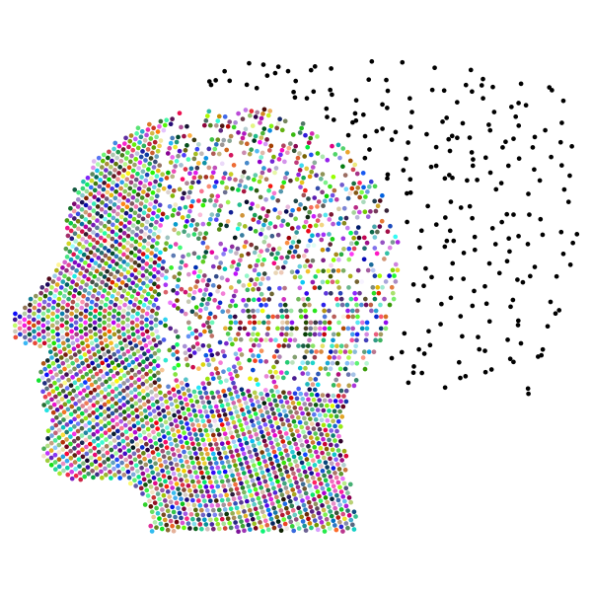
INTRODUCTION
GR29 MULTIMODAL AI FRAMEWORK FOR SOCIAL MEDIA BASED MENTAL DISORDER DETECTION AND PERSONALIZED WELLBEING INSIGHTS
Role of social media in mental health expression : People share emotions, struggles, and experiences on platforms like Twitter and Reddit.
Goal of the project : To detect mental health disorders early through the analysis of social media posts or by uploading images, videos, facial expression recognition, generating image captions ,manually inserting text and retrain model in the process.
Leveraging machine learning : Using advanced techniques like NLP and classification models to analyze text normally posted, extracted from image, audio and video.
JUNE 2025
@DEPT. OF CSE, TMSL

Slide 5

INTRODUCTION (CONTINUED)
GR29 MULTIMODAL AI FRAMEWORK FOR SOCIAL MEDIA BASED MENTAL DISORDER DETECTION AND PERSONALIZED WELLBEING INSIGHTS
Focus on text classification for the base model : Analyzing language patterns to classify posts related to mental health issues.
Impact of early detection : Can enable timely intervention and direct users to mental health support services.
Models used in the project : Techniques like Logistic Regression, XGBoost are applied for high accuracy. Ensemble Model using the individual models is created to get higher accuracy and generalization.
JUNE 2025
@DEPT. OF CSE, TMSL

Slide 6

PROBLEM DEFINITION
GR29 MULTIMODAL AI FRAMEWORK FOR SOCIAL MEDIA BASED MENTAL DISORDER DETECTION AND PERSONALIZED WELLBEING INSIGHTS
Rising prevalence of mental health disorders : Increasing cases of depression, anxiety, PTSD, and other mental health issues globally.
Challenges in early detection : Mental health problems are often undiagnosed until advanced stages, limiting timely intervention.
Vast amount of unstructured social media data : Social media platforms generate large volumes of text that can indicate mental health struggles.
Need for efficient detection methods : Manual analysis of social media posts is time-consuming; automation using machine learning is essential.
Goal : To develop a system that accurately classifies social media posts based on mental health disorders.
JUNE 2025
@DEPT. OF CSE, TMSL

Slide 7
OUR CONTRIBUTION AND UNIQUENESS OF PROJECT
GR29 MULTIMODAL AI FRAMEWORK FOR SOCIAL MEDIA BASED MENTAL DISORDER DETECTION AND PERSONALIZED WELLBEING INSIGHTS
Use technology to assist mental health professionals and enhance public health awareness by implementing different features in a single application
Implement text analysis to detect mental health concerns from user inputs.
Develop an image analysis system for text extraction, facial expression recognition, and gesture analysis.
Create a video analysis module for converting video to audio, extracting text, and recognizing expressions.
Incorporate image captioning using transformers to contribute to mental wellbeing insights.
Build a system to fetch and analyze Reddit and Twitter user posts for mental health classification.
Enable multilingual analysis by translating non-English content to English.
Use generative AI to map mental health classifications to Ryff's Scale of Psychological Well Being.
Provide data visualization for emotional trends and post analysis.
Develop an ensemble model with multiple algorithms for robust mental health classification.
Integrate a feature to retrain the model with user-provided data for continuous improvement.
JUNE 2025
@DEPT. OF CSE, TMSL

Slide 8
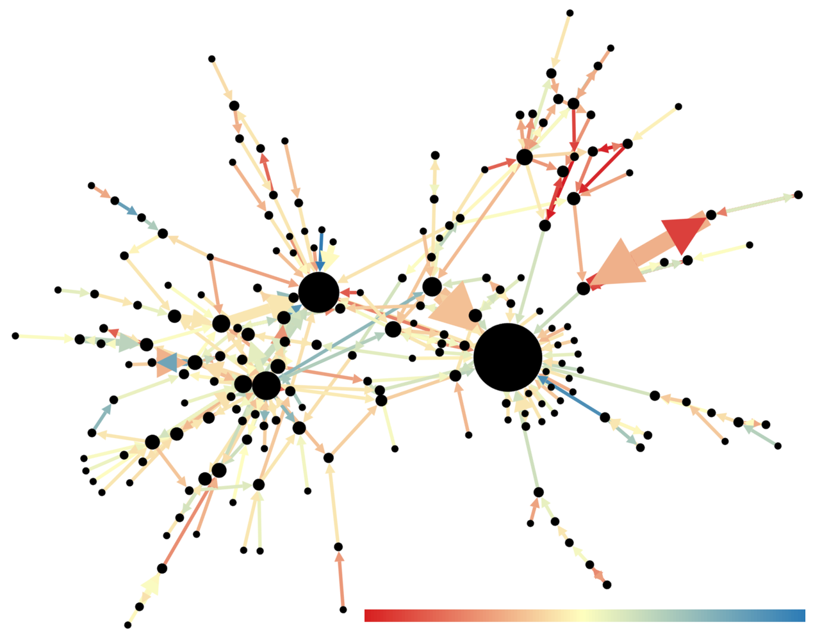
RESEARCH WORK
GR29 MULTIMODAL AI FRAMEWORK FOR SOCIAL MEDIA BASED MENTAL DISORDER DETECTION AND PERSONALIZED WELLBEING INSIGHTS
Social media and mental health research Explored studies on how social media data can reveal mental health conditions.
Key study by Choudhury et al. (2013) Showed the predictive power of Twitter data in identifying depression through linguistic patterns.
Guntuku et al. (2017) review Synthesized various approaches to detecting mental illness using sentiment analysis on social platforms.
Mathur et al. (2022) systematic review Highlighted the success of machine learning techniques in detecting disorders like depression and anxiety.
JUNE 2025
@DEPT. OF CSE, TMSL

Slide 9
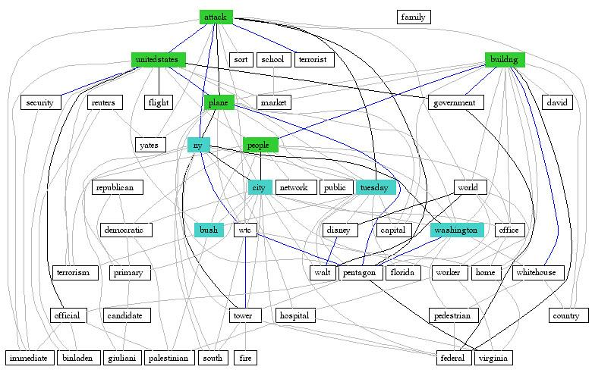
RESEARCH WORK (CONTINUED)
GR29 MULTIMODAL AI FRAMEWORK FOR SOCIAL MEDIA BASED MENTAL DISORDER DETECTION AND PERSONALIZED WELLBEING INSIGHTS
Nadeem (2016) study on Twitter Demonstrated the potential of text analysis to identify at-risk individuals based on emotional cues in tweets.
Al Sagri and Ykhlef (2020) approach Combined linguistic and behavioral features for more accurate depression detection on Twitter.
Recent study by Vaishnavi et al. (2022) Comparative analysis of algorithms to identify mental health conditions from social media posts.
Ethical considerations by Safa et al. (2023) Addressed data privacy challenges in mental health detection research using social media data.
JUNE 2025
@DEPT. OF CSE, TMSL

Slide 10

RESEARCH WORK (CONTINUED)
GR29 MULTIMODAL AI FRAMEWORK FOR SOCIAL MEDIA BASED MENTAL DISORDER DETECTION AND PERSONALIZED WELLBEING INSIGHTS
The study "Single classifier vs. ensemble machine learning approaches for mental health prediction" demonstrates that Gradient Boosting (88.80%) and Neural Networks (88.00%) outperform ensemble models (85.60%) for mental health issue prediction, based on survey data from OSMI.
The paper "Ensemble of hybrid model-based technique for early detection of depression" introduces a hybrid SVM-MLP model with SMOTE for class balancing, achieving 99.39% accuracy and 99.51% F1-score, highlighting its efficacy in early depression detection.
The research "Survey of transformers and towards ensemble learning using transformers for NLP" reviews transformer models and explores ensemble learning with transformers, showcasing their superior performance in NLP tasks like sentiment analysis and text generation.
JUNE 2025
@DEPT. OF CSE, TMSL

Slide 11
PROPOSED WORKFLOW
GR29 MULTIMODAL AI FRAMEWORK FOR SOCIAL MEDIA BASED MENTAL DISORDER DETECTION AND PERSONALIZED WELLBEING INSIGHTS
Data Collection : Collect Reddit posts using the PRAW API and extract labeled data for mental health categories like Normal, Anxiety, Depression, PTSD, and Bipolar.
Data Preprocessing : Clean the collected data by removing URLs, stopwords, and special characters. Normalize and tokenize the text, followed by converting it into numerical formats ( TF-IDF, Bag Of Words, Word2Vec, LIWC, N-Gram ) for analysis.
Model Training and Evaluation :Train machine learning models including Logistic Regression, Naive Bayes, SVM, Random Forest, XGBoost, KNN, LSTM and Transformers. Evaluate their performance using metrics such as accuracy, precision, recall, and F1-score. Apply Hyperparameter Tuning on ML models as needed to improve the accuracy further. Leverage Ensemble Learning with multiple models to get higher accuracy.
Testing and Deployment : Test the best-performing models and deploy them on a user-friendly interface using Streamlit. Ensure the system supports real-time classification for various inputs.like text, image, video and user profiles from social media platforms like Reddit and Twitter.
JUNE 2025
@DEPT. OF CSE, TMSL

Slide 12
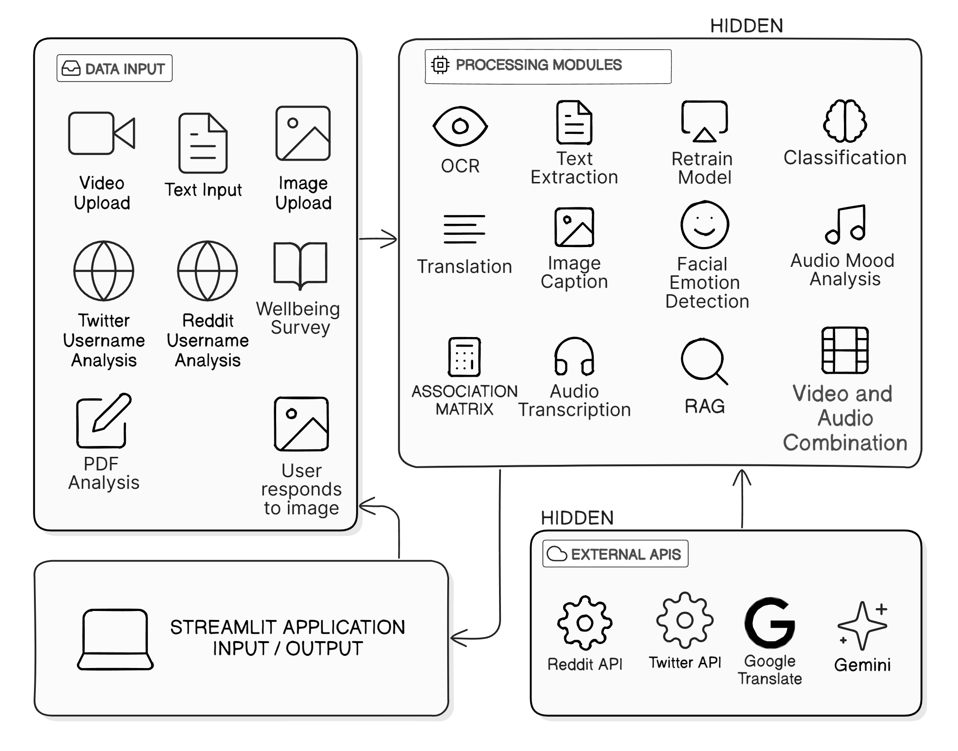
PROPOSED WORKFLOW (CONTINUED)
GR29 MULTIMODAL AI FRAMEWORK FOR SOCIAL MEDIA BASED MENTAL DISORDER DETECTION AND PERSONALIZED WELLBEING INSIGHTS
SYSTEM OVERVIEW
JUNE 2025
@DEPT. OF CSE, TMSL

Slide 13
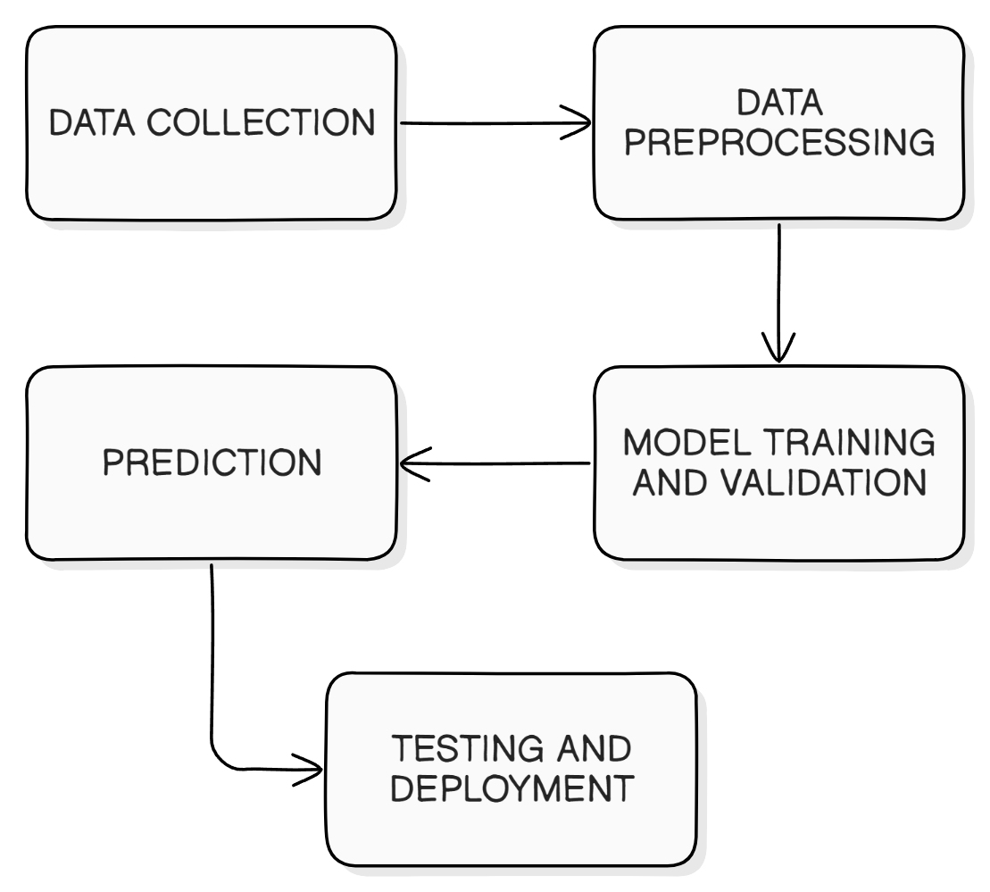
PROPOSED WORKFLOW (CONTINUED)
GR29 MULTIMODAL AI FRAMEWORK FOR SOCIAL MEDIA BASED MENTAL DISORDER DETECTION AND PERSONALIZED WELLBEING INSIGHTS
PROJECT MODULES
JUNE 2025
@DEPT. OF CSE, TMSL

Slide 14
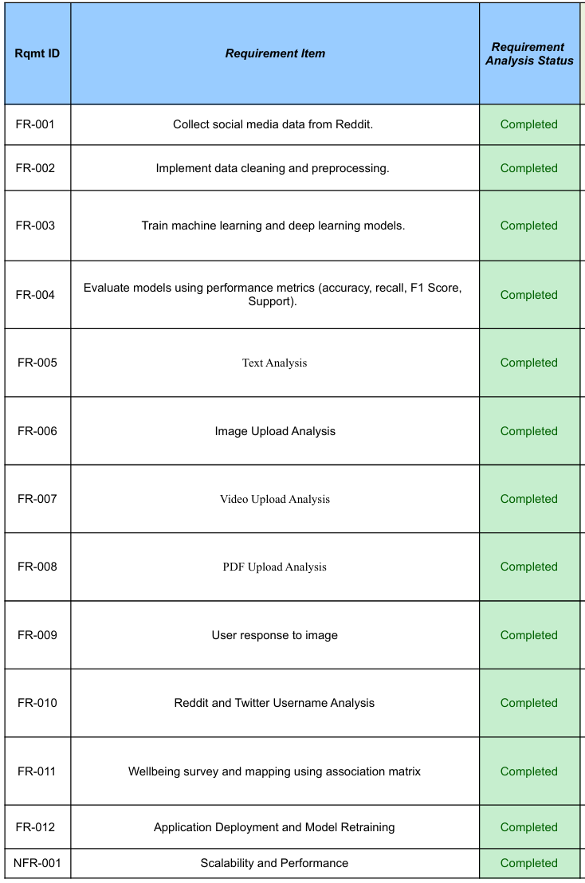
IMPLEMENTATION
GR29 MULTIMODAL AI FRAMEWORK FOR SOCIAL MEDIA BASED MENTAL DISORDER DETECTION AND PERSONALIZED WELLBEING INSIGHTS
Data Collection : Scraped Reddit posts related to mental health issues and for analysis.
Data Preprocessing : Cleaned and normalized the text by removing URLs, stop-words, punctuation, and applied tokenization and lemmatization techniques.
Feature Extraction : Utilized Bag of Words, Term Frequency-Inverse Document Frequency (TF-IDF), Word2Vec, LIWC, N-Gram to convert text into numerical format for machine learning models.
Splitting the Dataset : Divided the dataset into training and testing sets to train models and evaluate their performance. Also applied Stratified K-fold Cross Validation
FUNCTIONAL REQUIREMENTS
JUNE 2025
@DEPT. OF CSE, TMSL

Slide 15
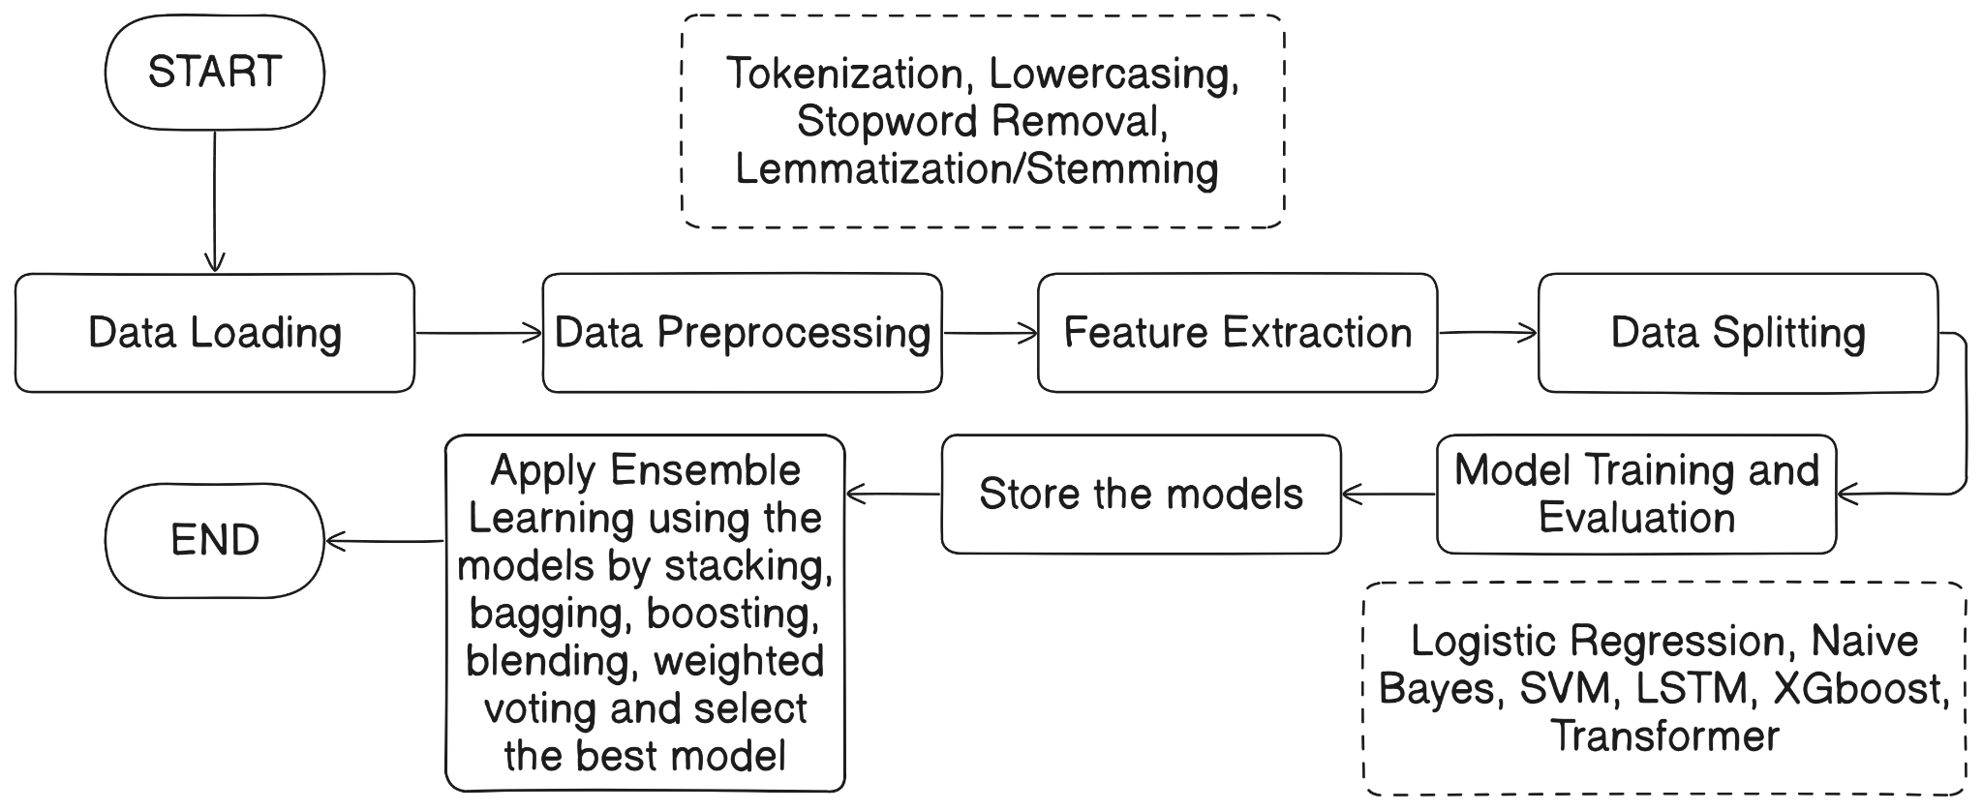
IMPLEMENTATION (CONTINUED)
GR29 MULTIMODAL AI FRAMEWORK FOR SOCIAL MEDIA BASED MENTAL DISORDER DETECTION AND PERSONALIZED WELLBEING INSIGHTS
Model Training : Trained multiple models: Logistic Regression, k-Nearest Neighbors (k-NN), Support Vector Machine (SVM), Naive Bayes, Random Forest, XGBoost, Long Short Term Memory, Transformer and Ensemble Models.
Hyperparameter Tuning : Applied RandomizedSearchCV to optimize the performance of some models.
Model Evaluation : Used metrics like accuracy, precision, recall, F1-score, and confusion matrices to evaluate model effectiveness.
Prediction and Deployment : Implemented the best-performing model and deployed using Google Colab, Pyngrok and Streamlit.
MODEL WORKFLOW
JUNE 2025
@DEPT. OF CSE, TMSL

Slide 16
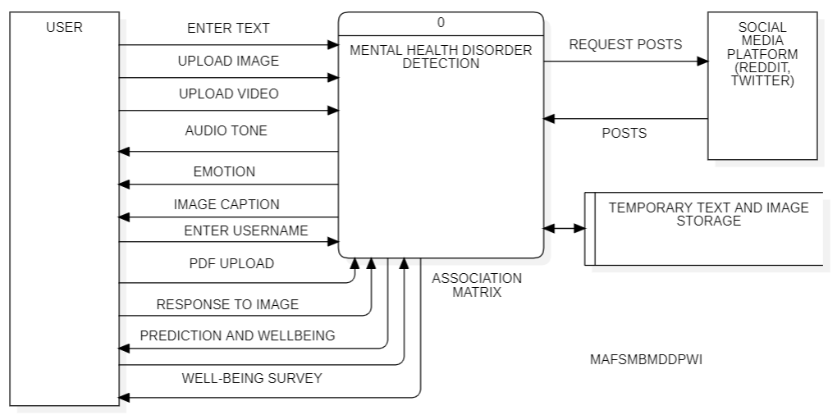
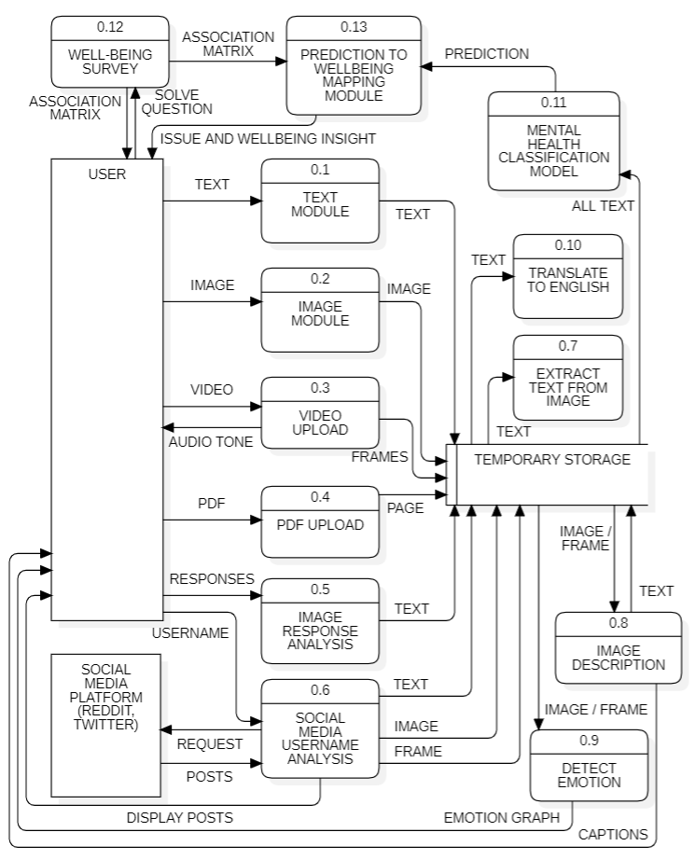
IMPLEMENTATION (CONTINUED)
GR29 MULTIMODAL AI FRAMEWORK FOR SOCIAL MEDIA BASED MENTAL DISORDER DETECTION AND PERSONALIZED WELLBEING INSIGHTS
DFD LEVEL 0
DFD LEVEL 1
JUNE 2025
@DEPT. OF CSE, TMSL

Slide 17
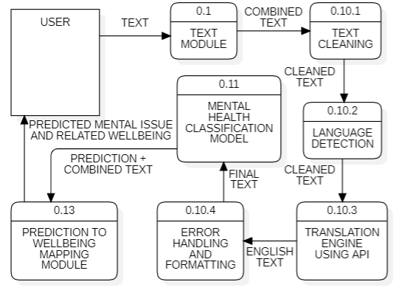
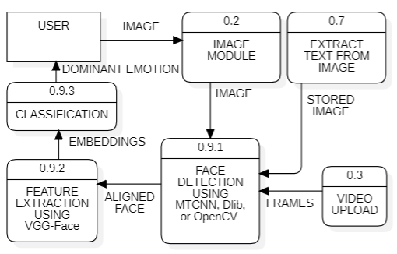
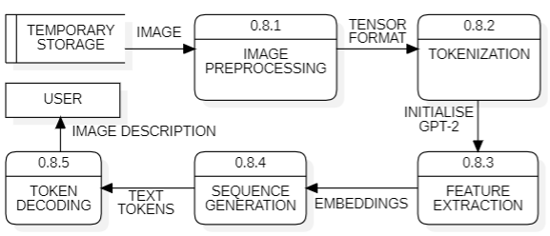
IMPLEMENTATION (CONTINUED)
GR29 MULTIMODAL AI FRAMEWORK FOR SOCIAL MEDIA BASED MENTAL DISORDER DETECTION AND PERSONALIZED WELLBEING INSIGHTS
TRANSLATE TO ENGLISH
EMOTION DETECTION
DFD LEVEL 2 DIAGRAMS
IMAGE DESCRIPTION
JUNE 2025
@DEPT. OF CSE, TMSL

Slide 18
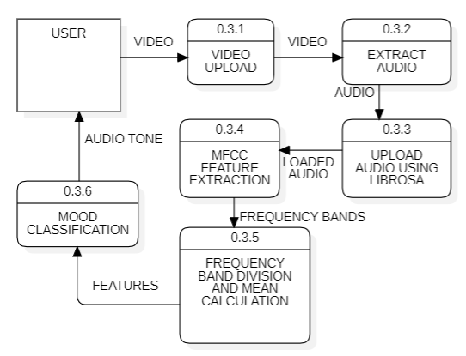
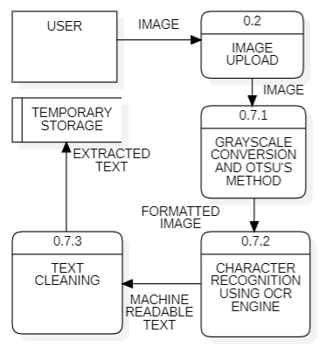
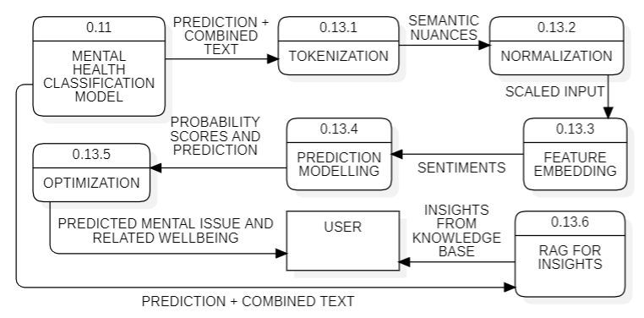
IMPLEMENTATION (CONTINUED)
GR29 MULTIMODAL AI FRAMEWORK FOR SOCIAL MEDIA BASED MENTAL DISORDER DETECTION AND PERSONALIZED WELLBEING INSIGHTS
AUDIO MOOD ANALYSIS
TEXT FROM IMAGE
PREDICTION TO WELLBEING
DFD LEVEL 2 DIAGRAMS
JUNE 2025
@DEPT. OF CSE, TMSL

Slide 19
RESULTS AND ANALYSIS
GR29 MULTIMODAL AI FRAMEWORK FOR SOCIAL MEDIA BASED MENTAL DISORDER DETECTION AND PERSONALIZED WELLBEING INSIGHTS
Logistic Regression : Achieved consistent performance with high accuracy. Precision and recall indicate reliable classification for balanced datasets.
Naive Bayes : Performed well with text data, especially for independent features. Precision was slightly lower for imbalanced classes but remained effective overall. Got better performance after applying hyperparameter tuning.
Support Vector Machine (SVM) : Delivered high accuracy for nonlinear classification tasks. The model showed robustness with complex feature interactions.
Random Forest : Provided strong classification performance with reduced overfitting. Achieved balanced precision and recall across all mental health classes.
XGBoost : Delivered the highest accuracy and efficiency. The model demonstrated excellent handling of imbalanced datasets with robust predictions.
LSTM : Outperformed traditional methods for sequential data. Captured contextual and temporal information effectively, achieving competitive results with complex text patterns.
Transformer : Gave the highest accuracy when implemented separately. Used in Ensemble Learning and improved the overall accuracy of the final model.
K-nearest Neighbours : Performed poorly and gave the worst accuracies among all.
JUNE 2025
@DEPT. OF CSE, TMSL

Slide 20
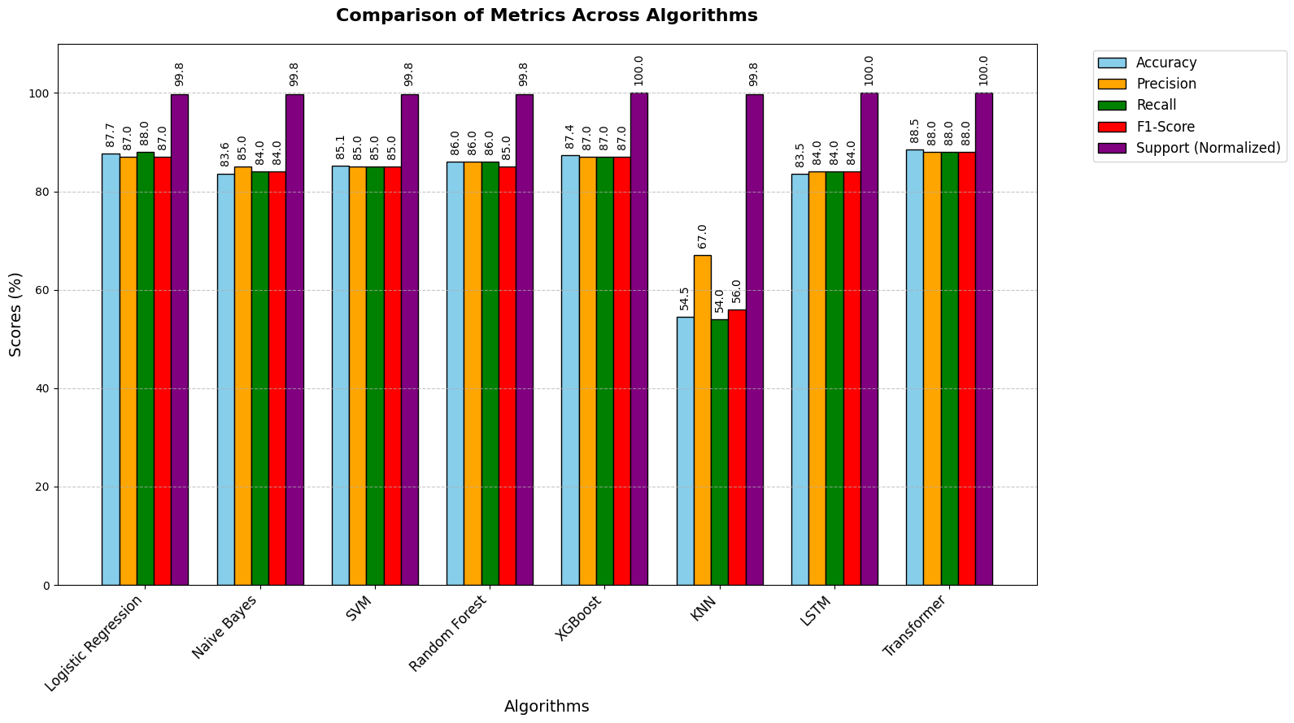
RESULTS AND ANALYSIS (CONTINUED)
GR29 MULTIMODAL AI FRAMEWORK FOR SOCIAL MEDIA BASED MENTAL DISORDER DETECTION AND PERSONALIZED WELLBEING INSIGHTS
RESULT COMPARISON OF DIFFERENT MODELS
JUNE 2025
@DEPT. OF CSE, TMSL

Slide 21
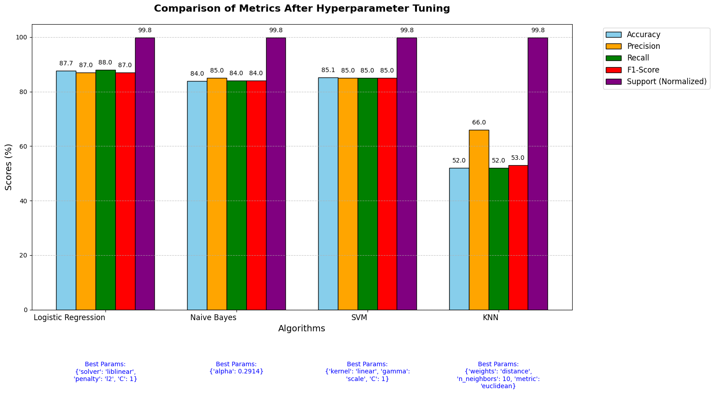
RESULTS AND ANALYSIS (CONTINUED)
GR29 MULTIMODAL AI FRAMEWORK FOR SOCIAL MEDIA BASED MENTAL DISORDER DETECTION AND PERSONALIZED WELLBEING INSIGHTS
RESULT COMPARISON OF DIFFERENT MODELS AFTER HYPERPARAMETER TUNING
JUNE 2025
@DEPT. OF CSE, TMSL

Slide 22
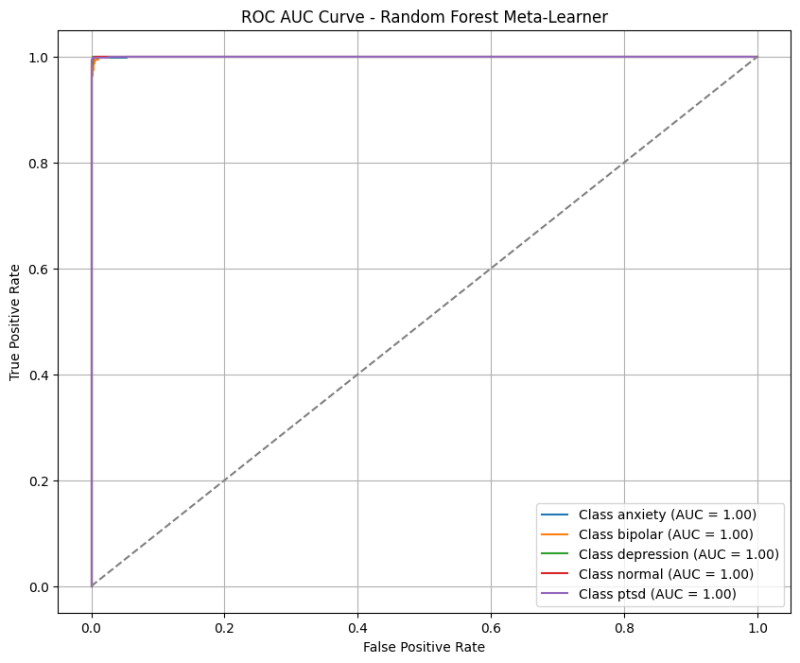
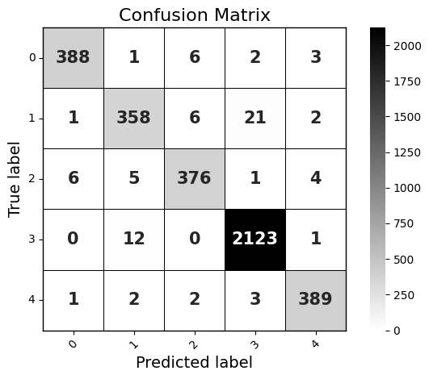
RESULTS AND ANALYSIS (CONTINUED)
GR29 MULTIMODAL AI FRAMEWORK FOR SOCIAL MEDIA BASED MENTAL DISORDER DETECTION AND PERSONALIZED WELLBEING INSIGHTS
ROC AUC CURVE
CONFUSION MATRIX
ENSEMBLE MODEL (BASE MODELS : LOGISTIC REGRESSION, NAIVE BAYES, SVM, XGBOOST, LSTM, TRANSFORMER & META LEARNER : RANDOM FOREST) WITH ACCURACY OF 98.03% WAS USED IN WEB APPLICATION
JUNE 2025
@DEPT. OF CSE, TMSL

Slide 23
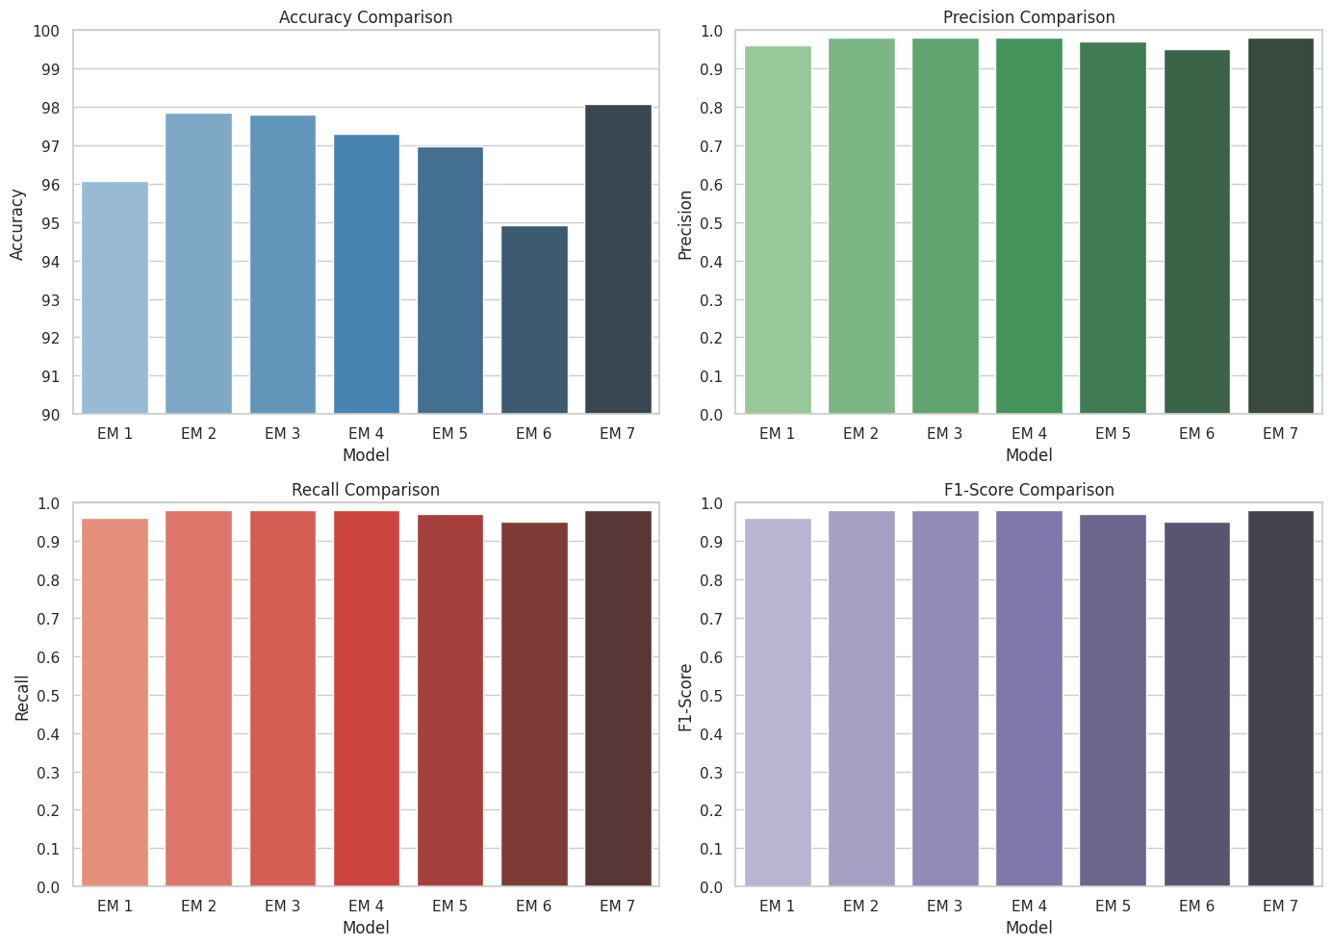
RESULTS AND ANALYSIS (CONTINUED)
GR29 MULTIMODAL AI FRAMEWORK FOR SOCIAL MEDIA BASED MENTAL DISORDER DETECTION AND PERSONALIZED WELLBEING INSIGHTS
COMPARISON OF DIFFERENT ENSEMBLE MODELS
JUNE 2025
@DEPT. OF CSE, TMSL

Slide 24
PROTOTYPE
GR29 MULTIMODAL AI FRAMEWORK FOR SOCIAL MEDIA BASED MENTAL DISORDER DETECTION AND PERSONALIZED WELLBEING INSIGHTS
Text Classification : Users can directly input text for immediate analysis and classification.
Image-based Classification : Extracts text from uploaded images using OCR (pytesseract), get captions and facial emotions to classify the content.
Video-based Classification : Processes uploaded video files, extract text from frames, transcribes speech to text, get captions and facial emotions to classify the content.
Userprofile Analysis : Enables analysing user profiles based on posts in Reddit and Twitter
A functional prototype was developed to classify mental health concerns from social media posts.
The system allows users to input text, upload images, or submit video for classification.
Key functionalities include text preprocessing, feature extraction, and prediction using trained machine learning models.
Real-time results display the most probable mental health concern with confidence scores.
Allow user to retrain model.
JUNE 2025
@DEPT. OF CSE, TMSL

Slide 25
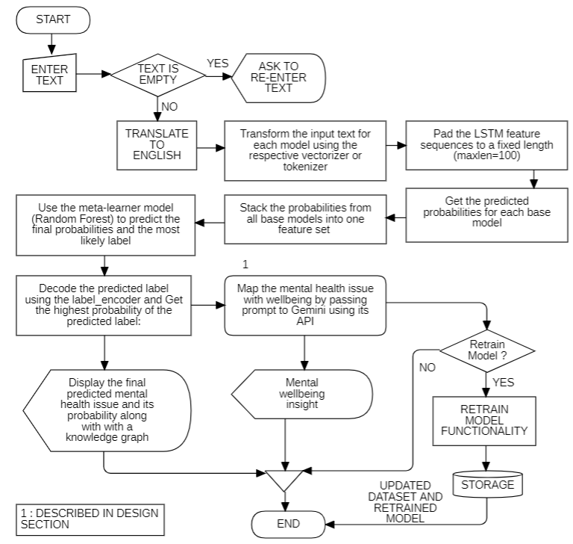
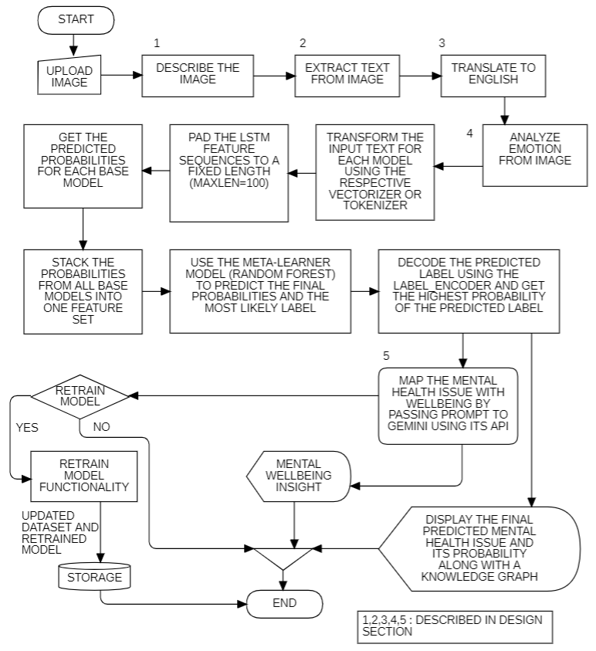
PROTOTYPE (CONTINUED)
GR29 MULTIMODAL AI FRAMEWORK FOR SOCIAL MEDIA BASED MENTAL DISORDER DETECTION AND PERSONALIZED WELLBEING INSIGHTS
TEXT CLASSIFICATION
IMAGE CLASSIFICATION
JUNE 2025
@DEPT. OF CSE, TMSL

Slide 26
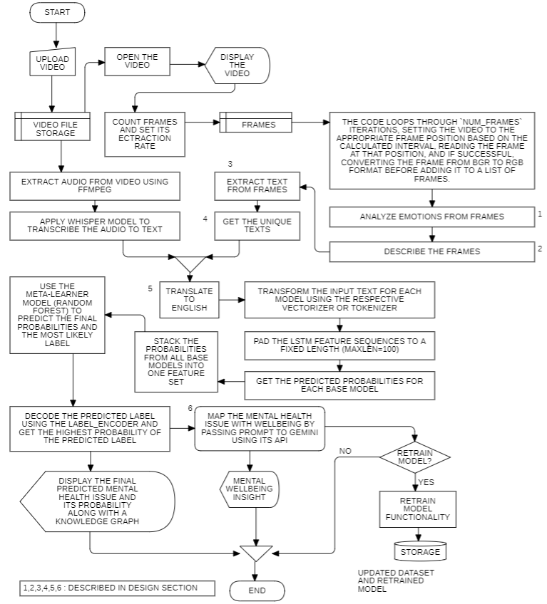
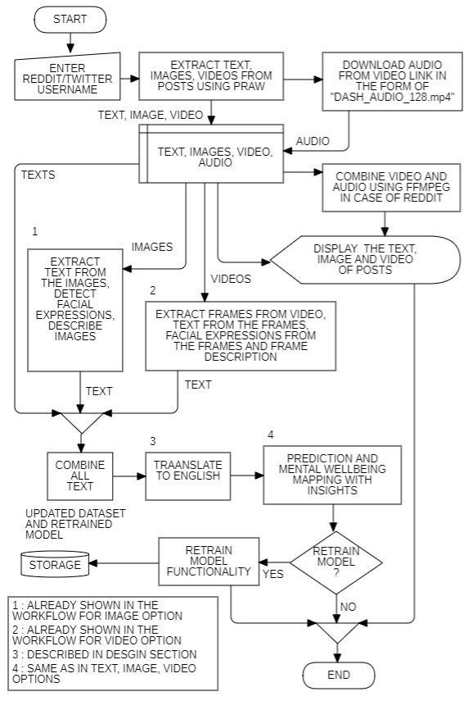
PROTOTYPE (CONTINUED)
GR29 MULTIMODAL AI FRAMEWORK FOR SOCIAL MEDIA BASED MENTAL DISORDER DETECTION AND PERSONALIZED WELLBEING INSIGHTS
VIDEO ANALYSIS
REDDIT AND TWITTER USERNAME ANALYSIS
JUNE 2025
@DEPT. OF CSE, TMSL

Slide 27
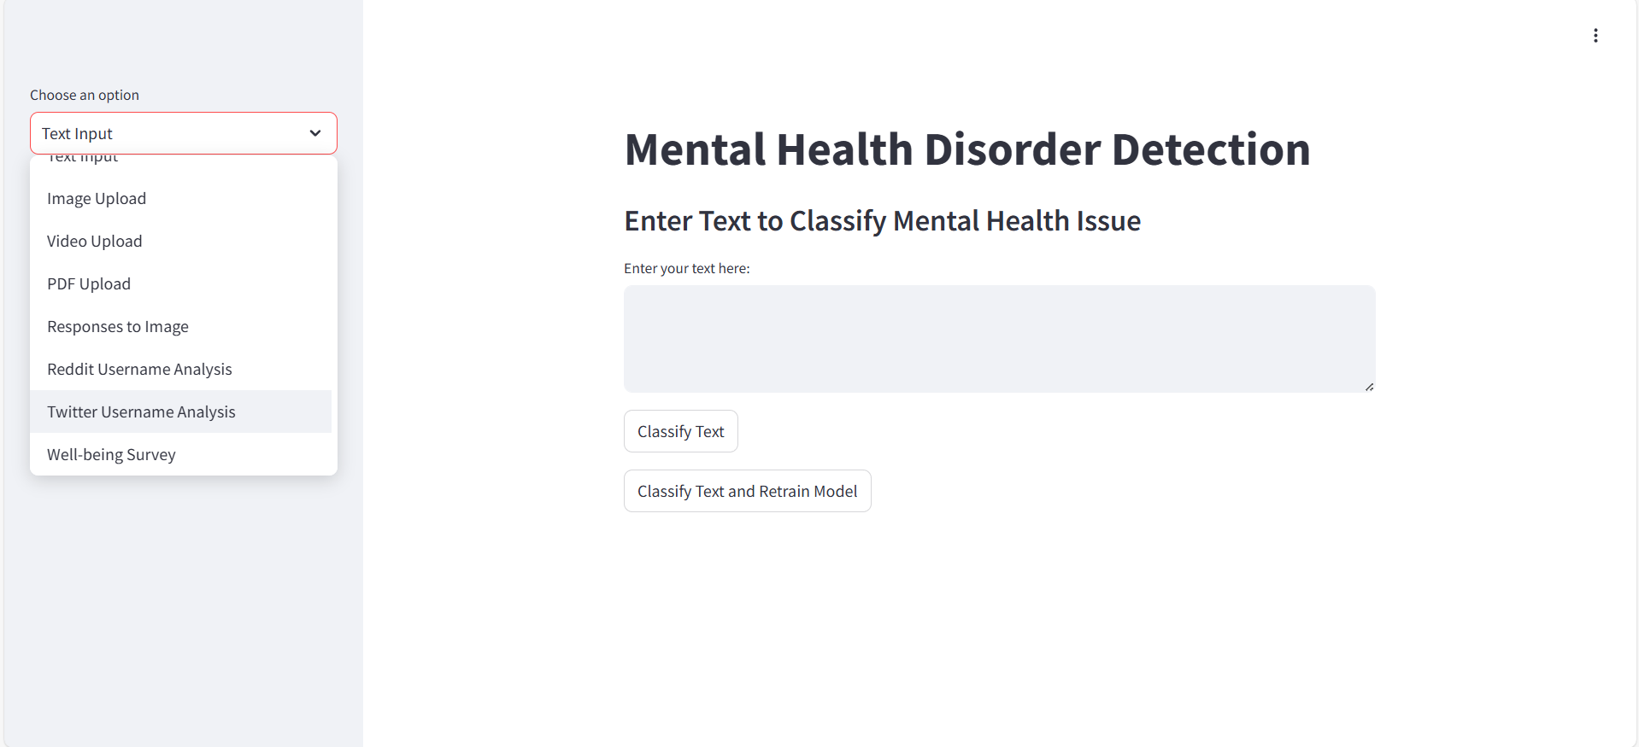
PROTOTYPE (CONTINUED)
GR29 MULTIMODAL AI FRAMEWORK FOR SOCIAL MEDIA BASED MENTAL DISORDER DETECTION AND PERSONALIZED WELLBEING INSIGHTS
WEB APPLICATION INTERFACE
JUNE 2025
@DEPT. OF CSE, TMSL

Slide 28
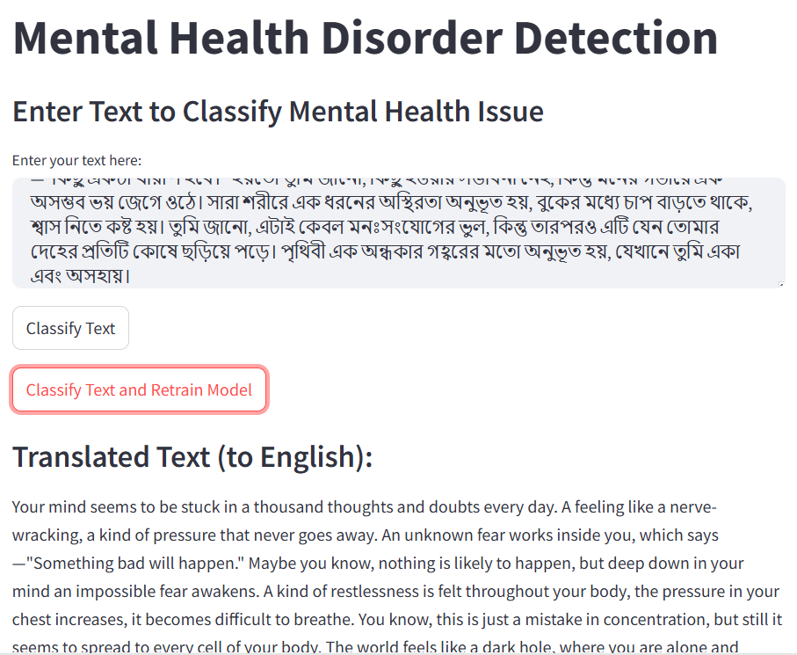
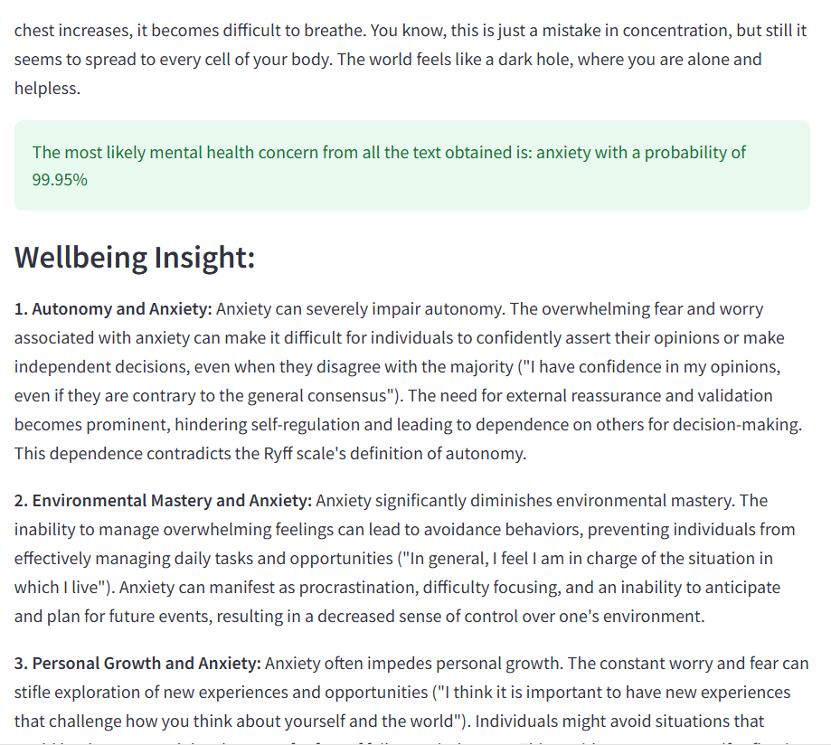
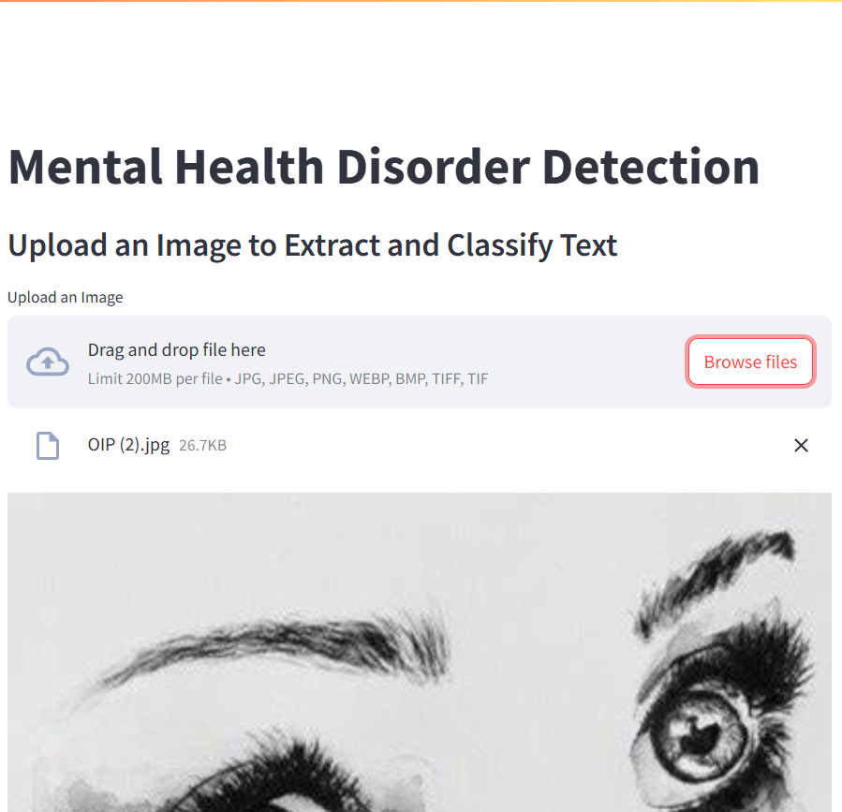
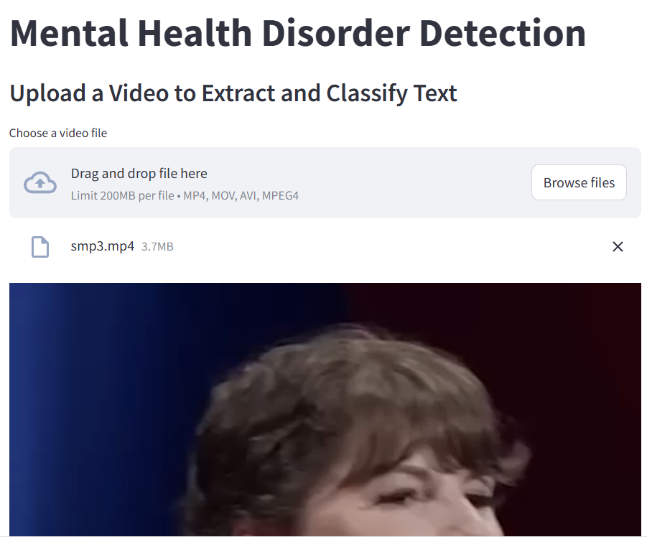
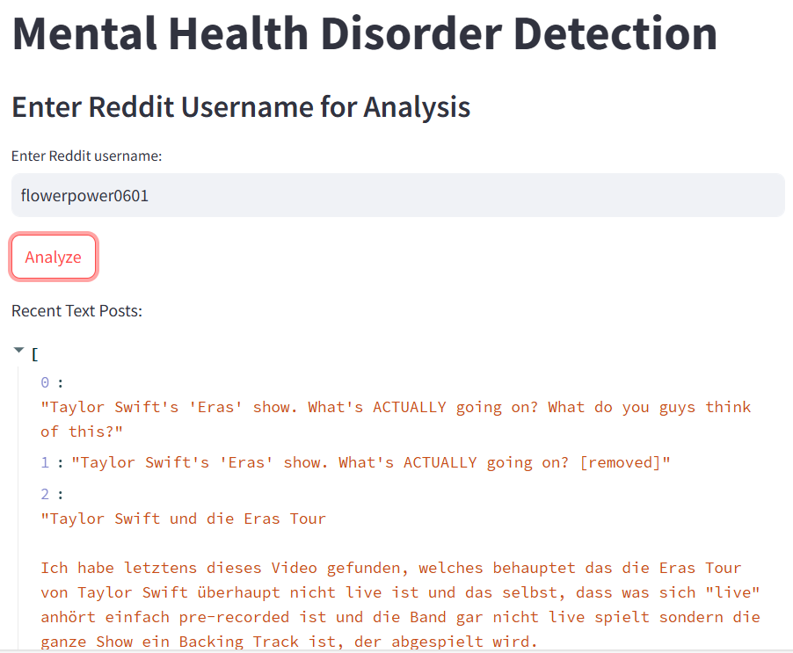
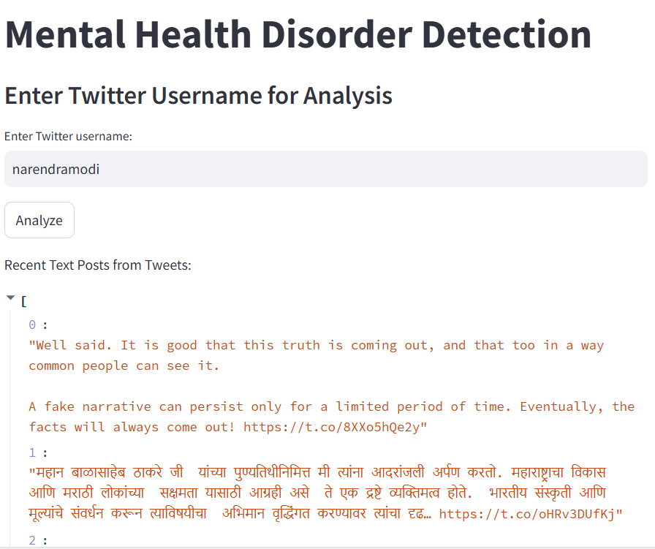
PROTOTYPE (CONTINUED)
GR29 MULTIMODAL AI FRAMEWORK FOR SOCIAL MEDIA BASED MENTAL DISORDER DETECTION AND PERSONALIZED WELLBEING INSIGHTS
WEB APPLICATION INTERFACE
JUNE 2025
@DEPT. OF CSE, TMSL

Slide 29
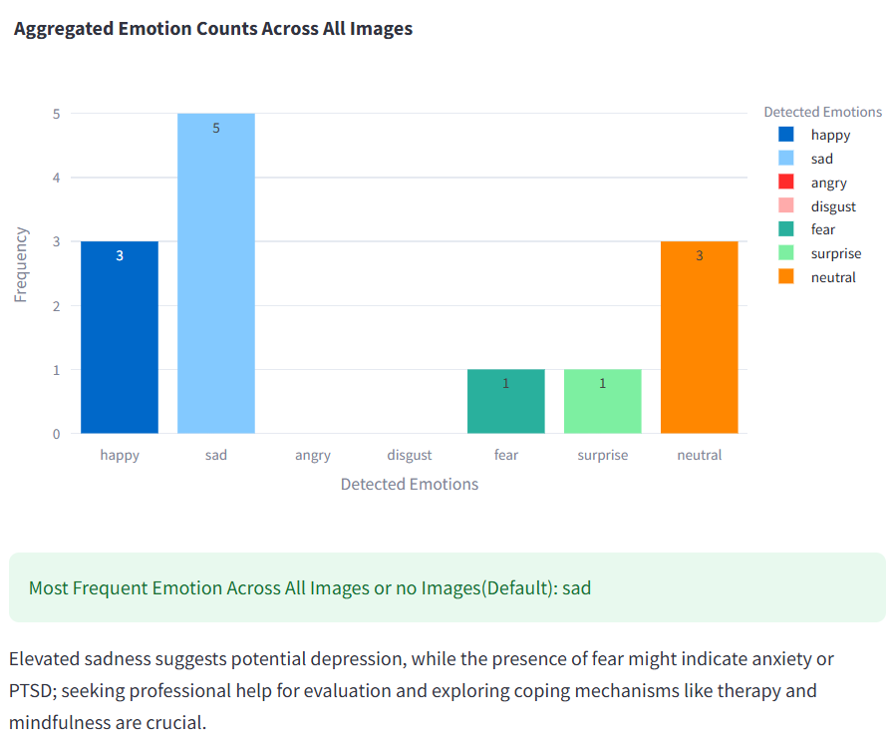
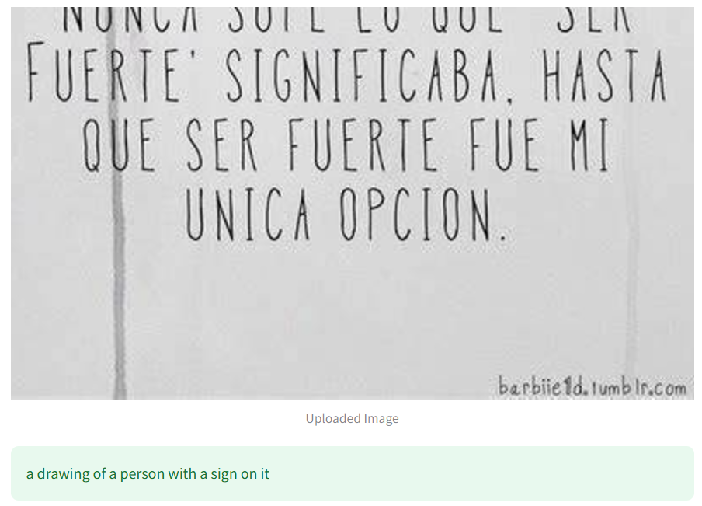
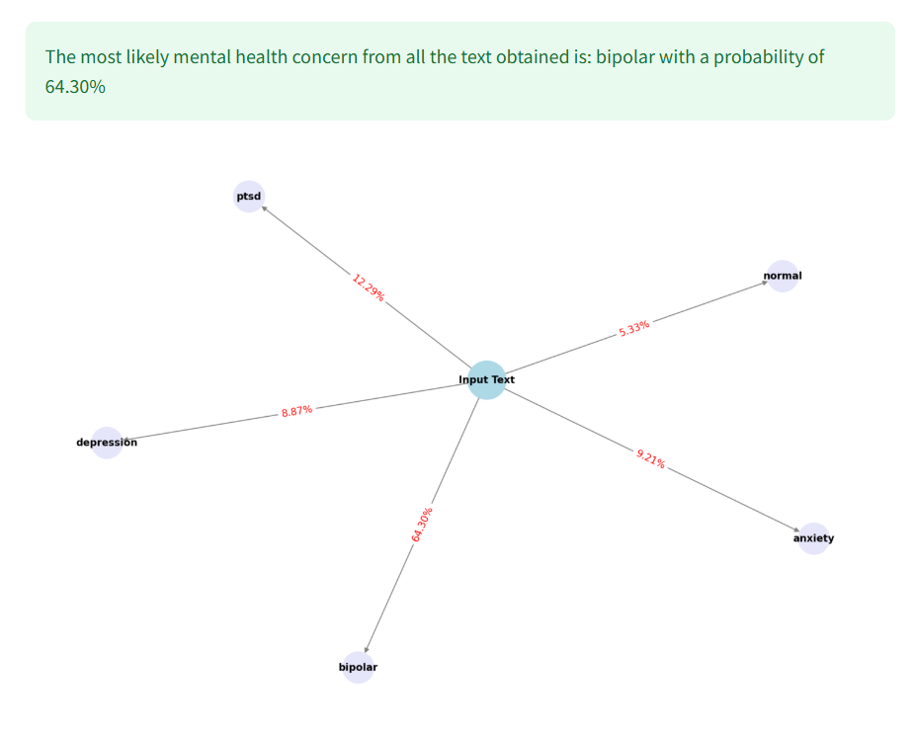
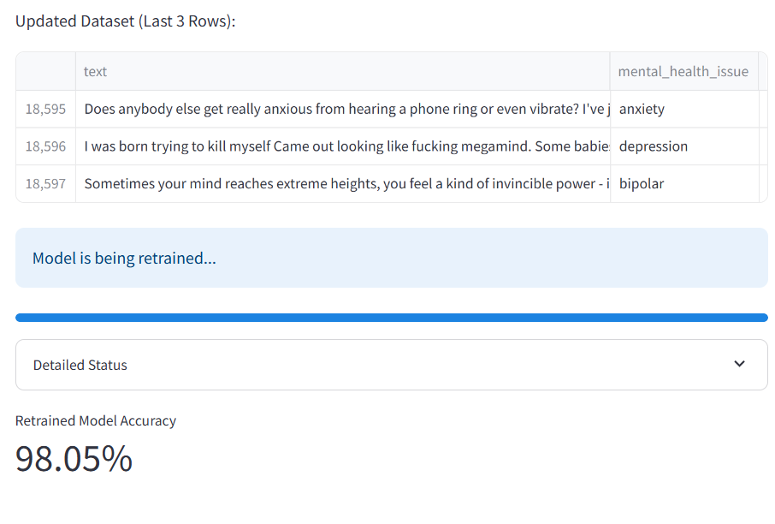
PROTOTYPE (CONTINUED)
GR29 MULTIMODAL AI FRAMEWORK FOR SOCIAL MEDIA BASED MENTAL DISORDER DETECTION AND PERSONALIZED WELLBEING INSIGHTS
WEB APPLICATION INTERFACE
JUNE 2025
@DEPT. OF CSE, TMSL

Slide 30
ADDITIONAL FEATURES
GR29 MULTIMODAL AI FRAMEWORK FOR SOCIAL MEDIA BASED MENTAL DISORDER DETECTION AND PERSONALIZED WELLBEING INSIGHTS
PDF UPLOAD ANALYSIS
Automated Text Extraction:
Utilize OCR to extract text from uploaded PDF files.
Convert scanned documents into machine-readable text.
Data Enrichment:
Integrate PDF content into the mental health dataset.
Enhance analysis with diverse sources of user-generated content.
Subsequent Analysis:
Apply models to evaluate and classify the extracted text.
Generate insights from PDF-based textual data.
JUNE 2025
@DEPT. OF CSE, TMSL

Slide 31
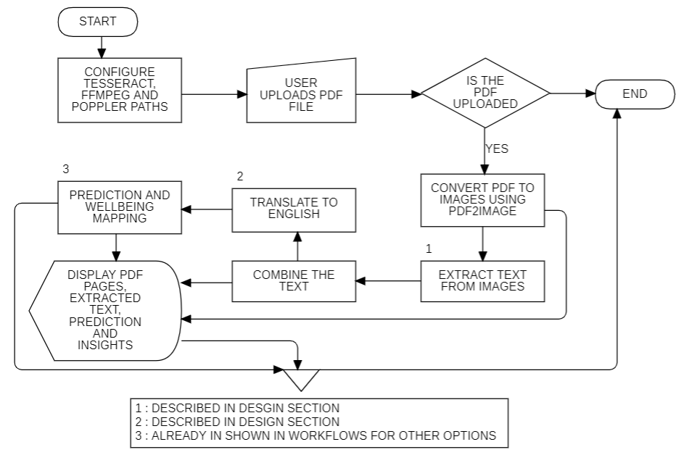
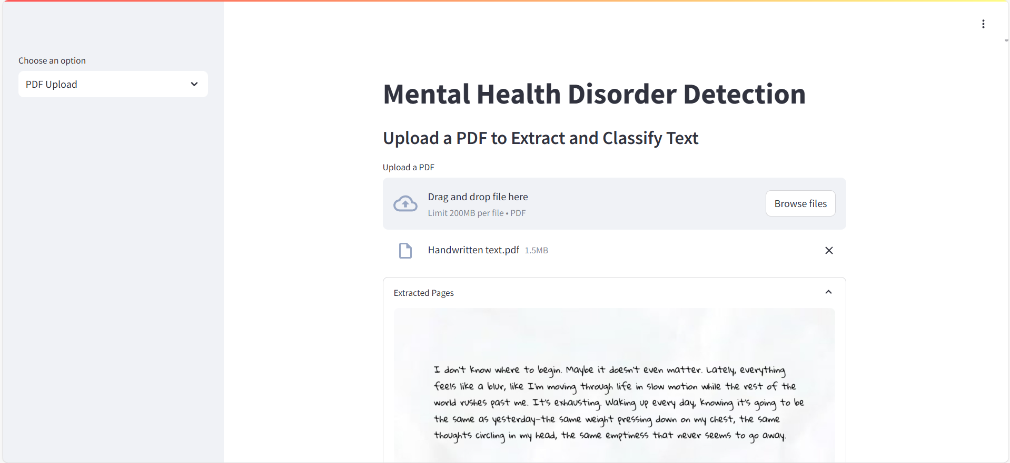
ADDITIONAL FEATURES (CONTINUED)
GR29 MULTIMODAL AI FRAMEWORK FOR SOCIAL MEDIA BASED MENTAL DISORDER DETECTION AND PERSONALIZED WELLBEING INSIGHTS
PDF UPLOAD OPTION
JUNE 2025
@DEPT. OF CSE, TMSL

Slide 32
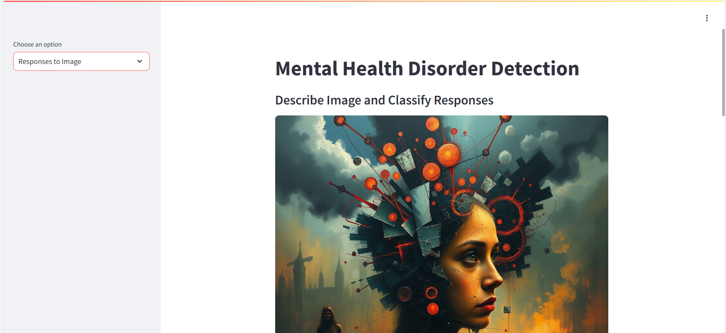
ADDITIONAL FEATURES (CONTINUED)
GR29 MULTIMODAL AI FRAMEWORK FOR SOCIAL MEDIA BASED MENTAL DISORDER DETECTION AND PERSONALIZED WELLBEING INSIGHTS
USER RESPONSE TO IMAGE SHOWN
Interactive Image-Based Feedback:
Capture user responses to images (e.g., via rating open-ended input) for some questions similar to Rorschach Inkblot Test.
Enhanced User Engagement:
Integrate visual feedback to improve overall classification accuracy.
Personalize insights based on user responses to visual stimuli.
JUNE 2025
@DEPT. OF CSE, TMSL

Slide 33
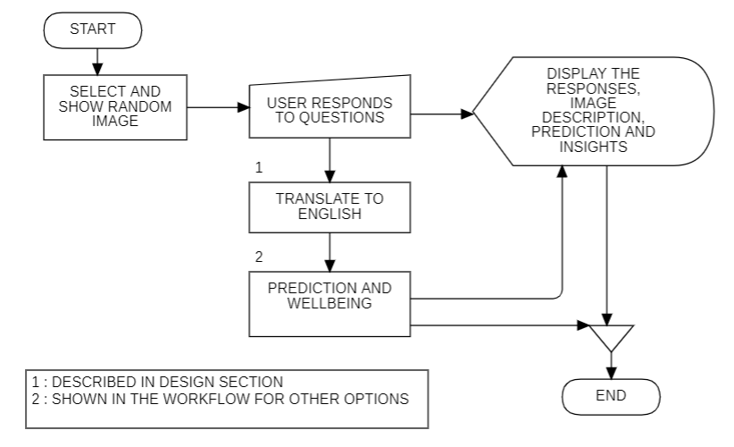
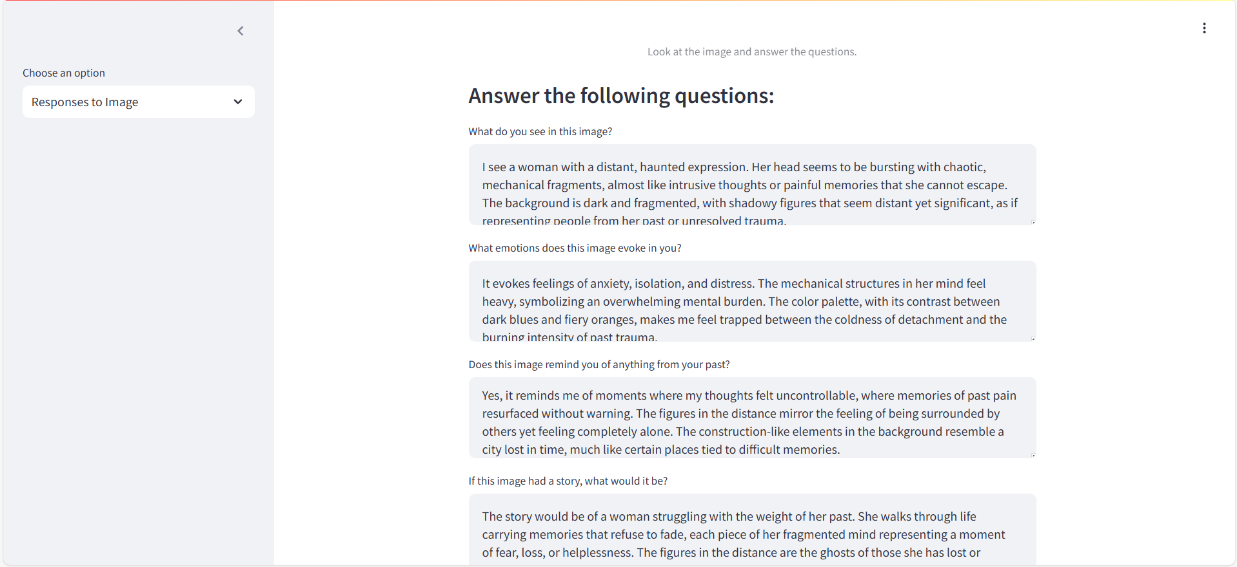
ADDITIONAL FEATURES (CONTINUED)
GR29 MULTIMODAL AI FRAMEWORK FOR SOCIAL MEDIA BASED MENTAL DISORDER DETECTION AND PERSONALIZED WELLBEING INSIGHTS
USER RESPONSE TO IMAGE OPTION
JUNE 2025
@DEPT. OF CSE, TMSL

Slide 34
ADDITIONAL FEATURES (CONTINUED)
GR29 MULTIMODAL AI FRAMEWORK FOR SOCIAL MEDIA BASED MENTAL DISORDER DETECTION AND PERSONALIZED WELLBEING INSIGHTS
WELLBEING SURVEY
Comprehensive Survey Deployment:
Collect user responses on mental health and well-being using a detailed survey.
Incorporate questions based on the Ryff Scale (Self-Acceptance, Autonomy, etc.).
Dynamic Association Matrix:
Update the association matrix using survey response data.
Compute weighted scores and similarity metrics (e.g., weighted sum, cosine similarity, euclidean distance).
Personalized Well-being Insights:
Generate targeted recommendations based on the computed association matrix.
Display consensus results that inform users about key well-being dimensions.
JUNE 2025
@DEPT. OF CSE, TMSL

Slide 35
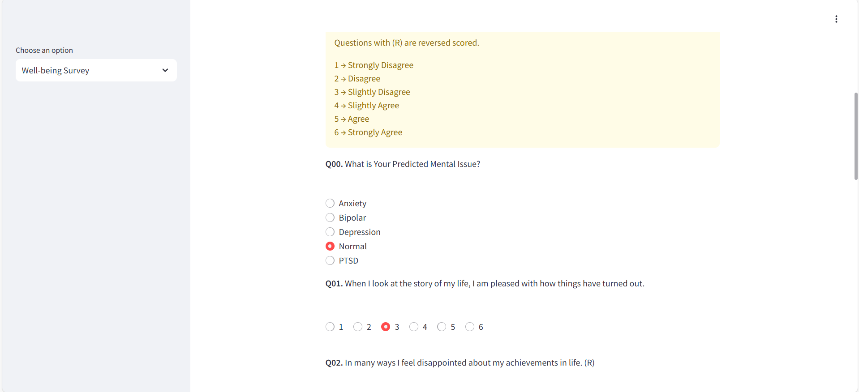
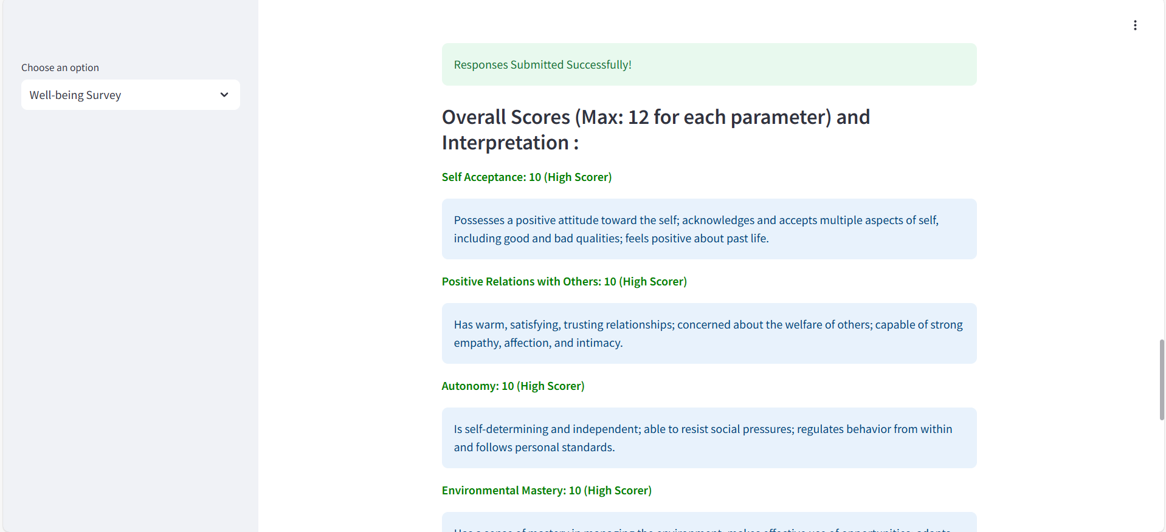
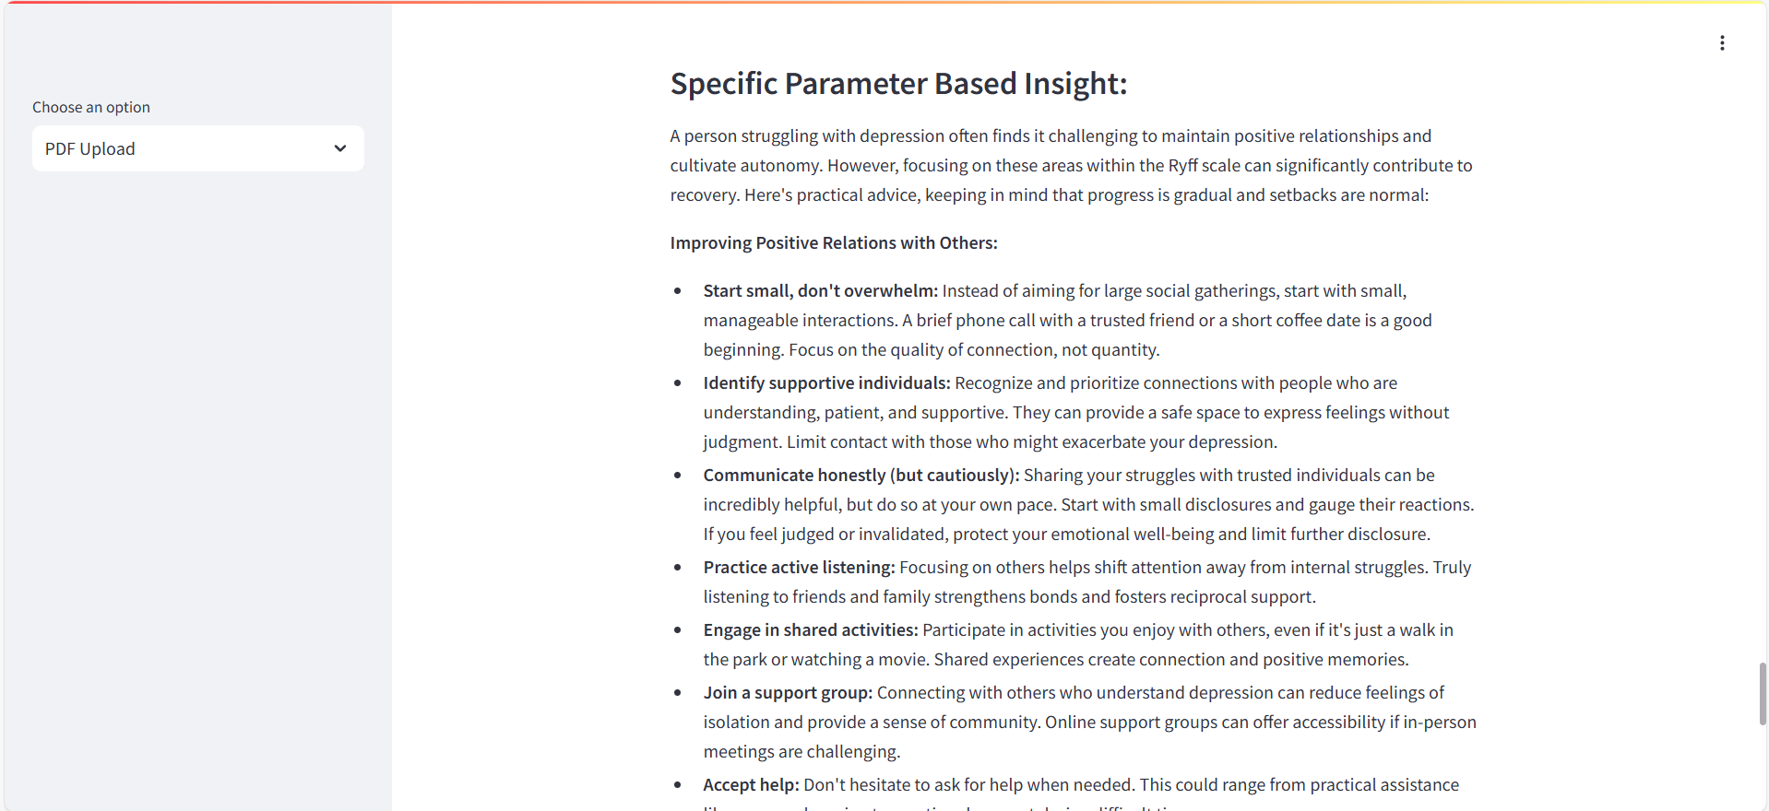
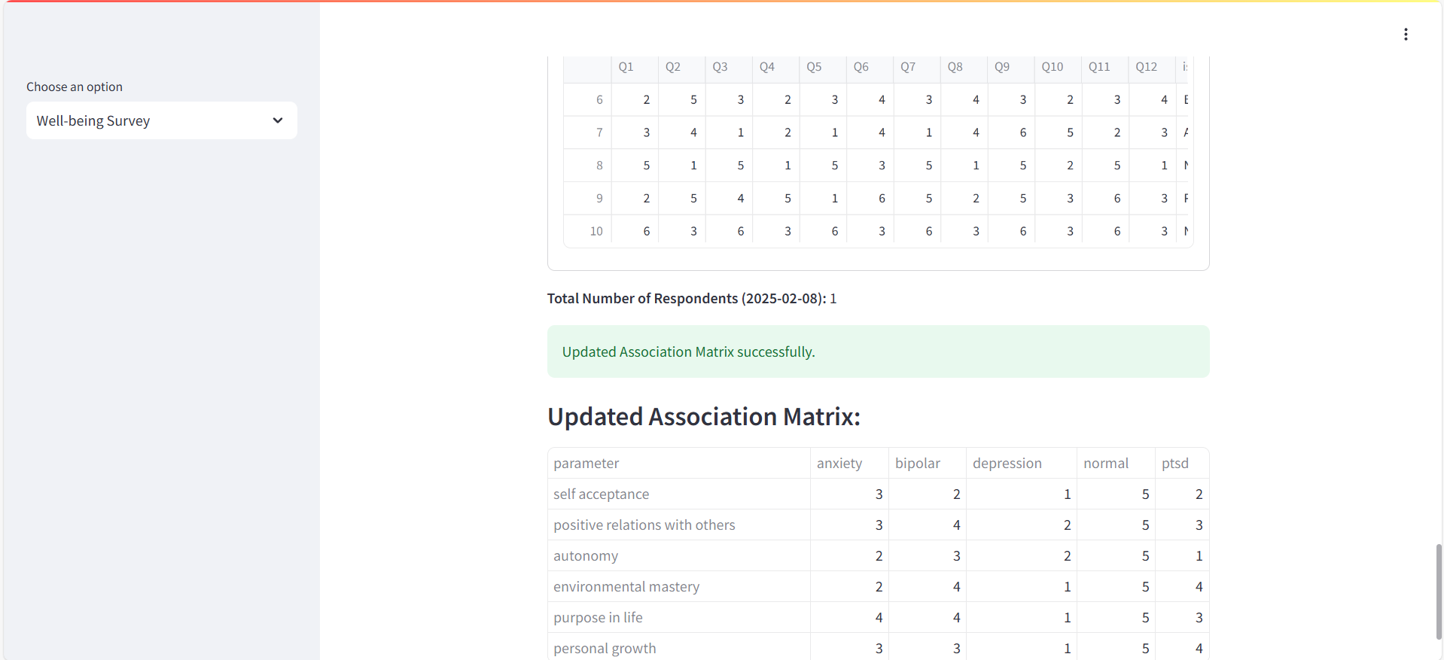
ADDITIONAL FEATURES (CONTINUED)
GR29 MULTIMODAL AI FRAMEWORK FOR SOCIAL MEDIA BASED MENTAL DISORDER DETECTION AND PERSONALIZED WELLBEING INSIGHTS
WELLBEING SURVEY AND ASSOCIATION MATRIX TO GET SPECIFIC PARAMETERS (MAX. 3)FROM THE 6 PARAMETERS OF THE RYFF’S SCALE OF PSYCHOLOGICAL WELL BEING
JUNE 2025
@DEPT. OF CSE, TMSL

Slide 36
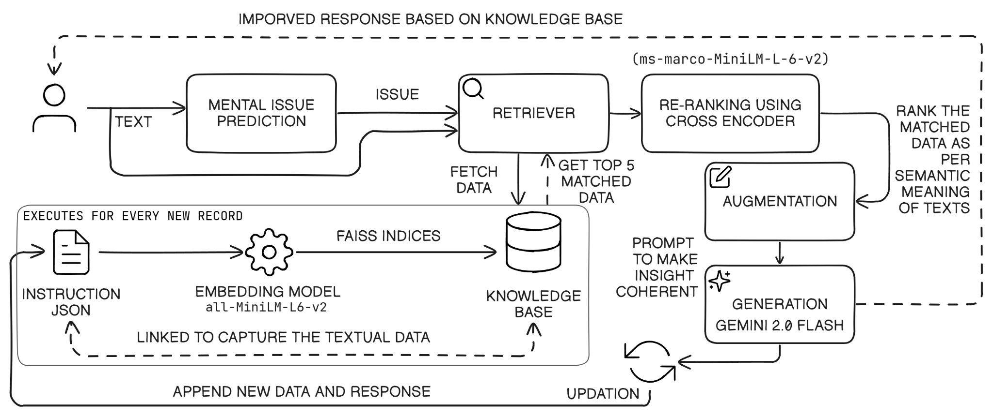
ADDITIONAL FEATURES (CONTINUED)
GR29 MULTIMODAL AI FRAMEWORK FOR SOCIAL MEDIA BASED MENTAL DISORDER DETECTION AND PERSONALIZED WELLBEING INSIGHTS
RAG FOR INSIGHTS
Built a Retrieval-Augmented Generation system for mental health wellbeing insights
Cleaned and combined multiple JSON datasets into a unified instruction-style format
Converted records into instruction, input, output format for generative querying
Generated vector embeddings using SentenceTransformer (all-MiniLM-L6-v2)
Indexed embeddings using FAISS with L2 (Euclidean) distance for similarity search
Retrieved top-matching records using FAISS, re-rank them using cross encoder and constructed an augmented prompt based on the context.
Sent the augmented prompt to Google Gemini API to generate wellbeing
Automatically updated the instruction JSON and FAISS vector store with every new input and Gemini response
OVERVIEW OF RAG FOR GENERATING INSIGHTS
JUNE 2025
@DEPT. OF CSE, TMSL

Slide 37
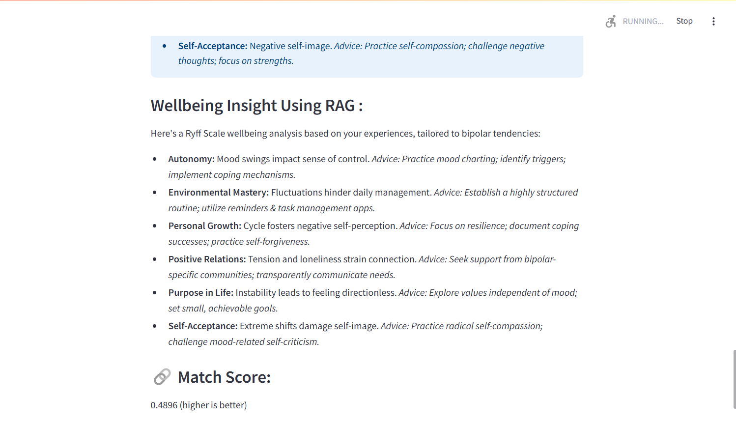
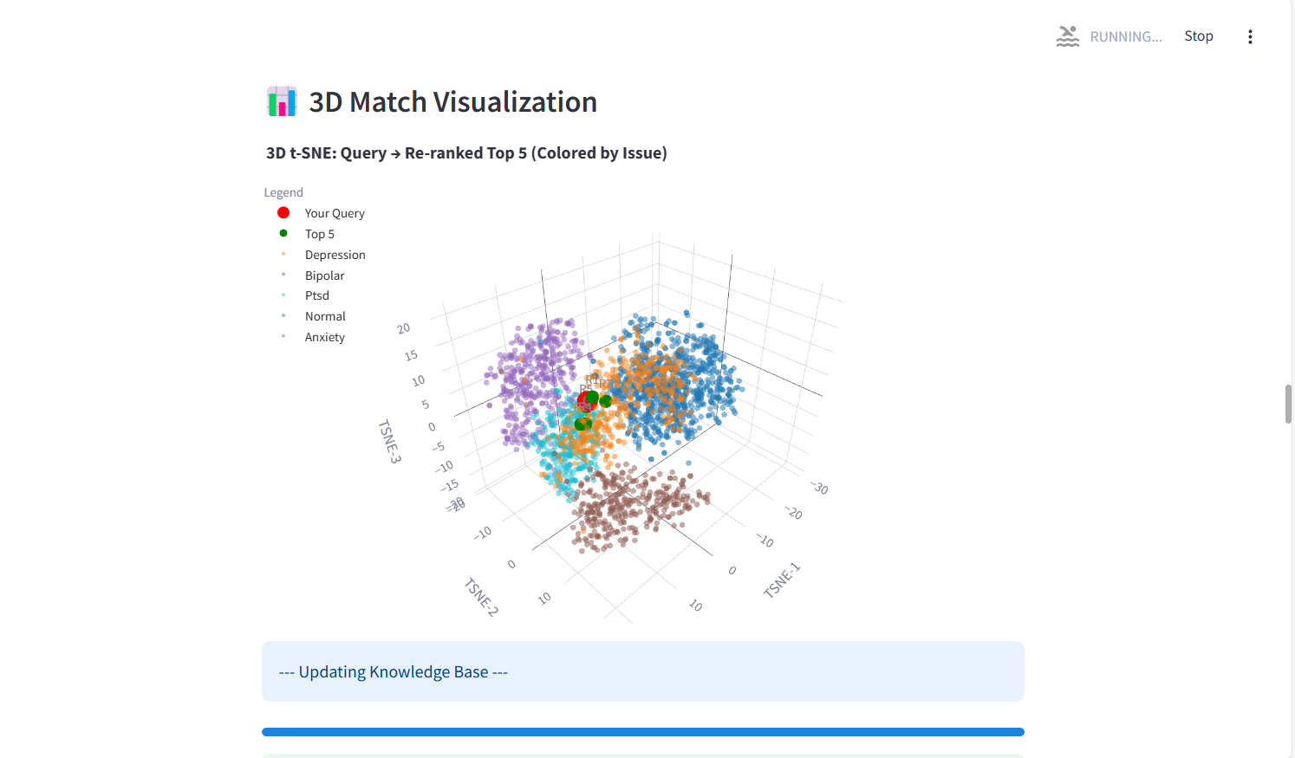
ADDITIONAL FEATURES (CONTINUED)
GR29 MULTIMODAL AI FRAMEWORK FOR SOCIAL MEDIA BASED MENTAL DISORDER DETECTION AND PERSONALIZED WELLBEING INSIGHTS
INSIGHTS GENERATED BY RAG
VISUALIZING MATCHES AND KNOWLEDGE BASE
JUNE 2025
@DEPT. OF CSE, TMSL

Slide 38
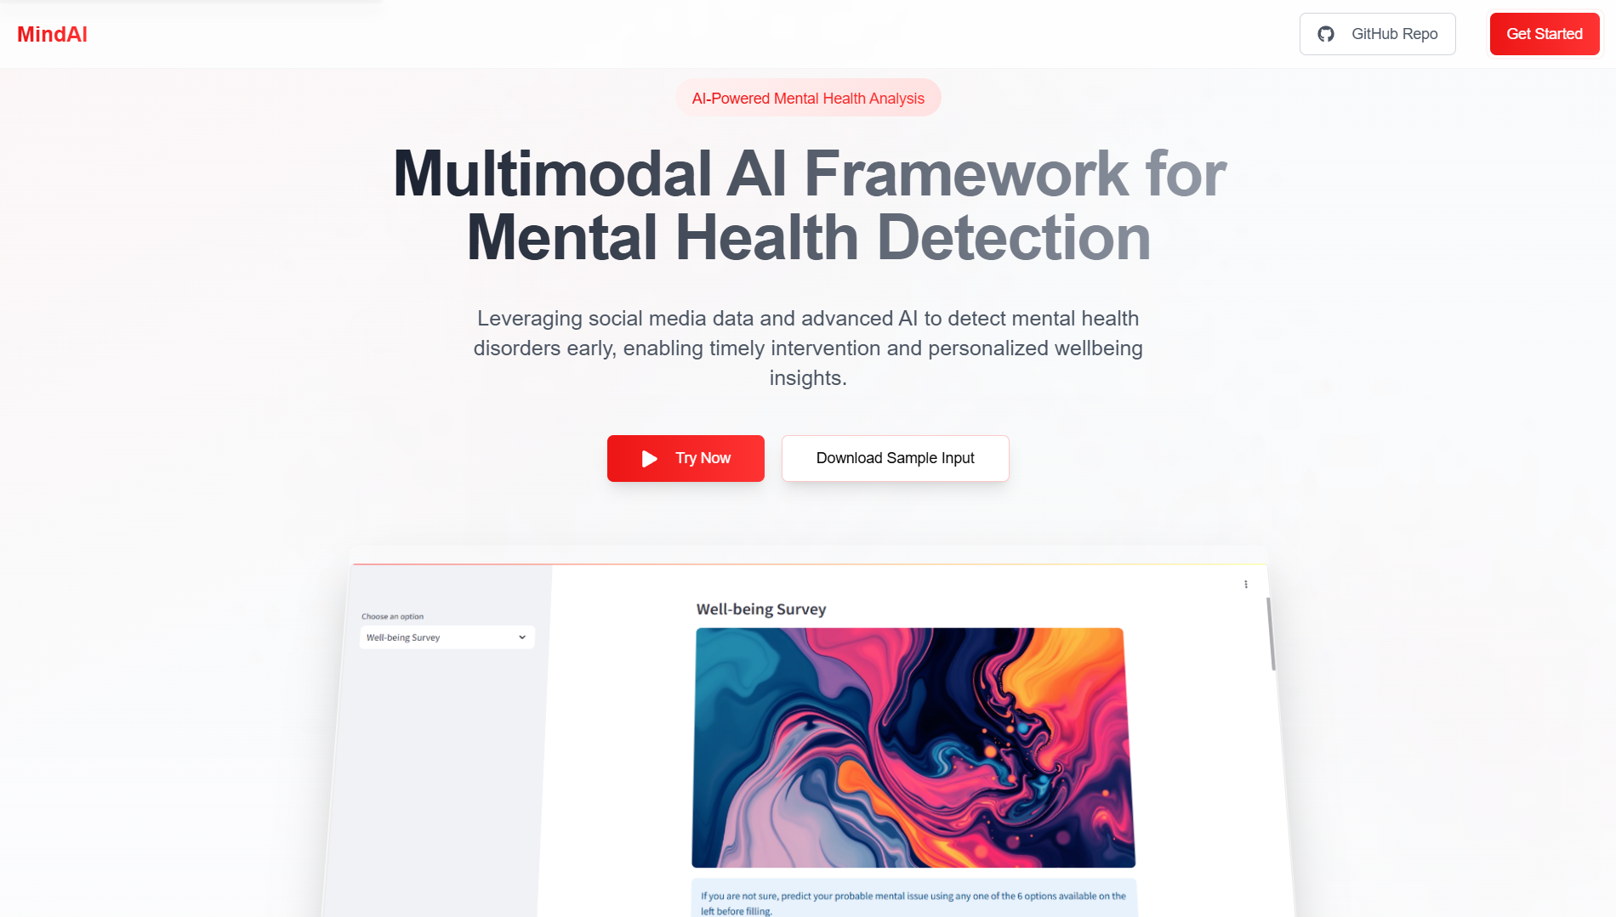
DEPLOYMENT
GR29 MULTIMODAL AI FRAMEWORK FOR SOCIAL MEDIA BASED MENTAL DISORDER DETECTION AND PERSONALIZED WELLBEING INSIGHTS
The application requires more resources than the free tier of Streamlit Cloud provides.
Main Application: Runs locally in Google Colab for better resource management.
Free Static Domain: Achieved using ngrok, allowing external access.
Landing Page: Provides a user-friendly interface to access the application.
Sample Inputs: Available for download via Google Drive.
🔗 Landing Page 📂 Sample Inputs
JUNE 2025
@DEPT. OF CSE, TMSL

Slide 39
CONCLUSION
GR29 MULTIMODAL AI FRAMEWORK FOR SOCIAL MEDIA BASED MENTAL DISORDER DETECTION AND PERSONALIZED WELLBEING INSIGHTS
Significance of the Project Developed a robust system for early detection of mental health disorders through social media analysis.
Effective Use of Machine Learning Leveraged various machine learning and deep learning models, identifying the model with the best performance.
Impact on Mental Health Awareness Provides valuable insights for mental health professionals and public health organizations, enabling proactive interventions.
Potential for Future Development Future enhancements with deep learning and multimodal data can lead to even better accuracy and insights.
Commitment to Ethical Practices Emphasizes the importance of user privacy and ethical considerations in handling sensitive mental health data.
JUNE 2025
@DEPT. OF CSE, TMSL

Slide 40

FUTURE SCOPE
GR29 MULTIMODAL AI FRAMEWORK FOR SOCIAL MEDIA BASED MENTAL DISORDER DETECTION AND PERSONALIZED WELLBEING INSIGHTS
Deploy the web application on cloud platforms like AWS, Azure, or Google Cloud to enhance scalability and accessibility.
Implement caching mechanisms to store frequently used data or computations, improving response times and computational efficiency.
Use threading to enable simultaneous processing for multiple users, ensuring smooth and efficient application performance.
Reduce dependency on GPUs by leveraging distributed systems for training models across multiple CPUs, improving cost efficiency.
Optimize the application to train models on larger datasets by partitioning the data and distributing workloads effectively across available resources.
JUNE 2025
@DEPT. OF CSE, TMSL

Slide 41
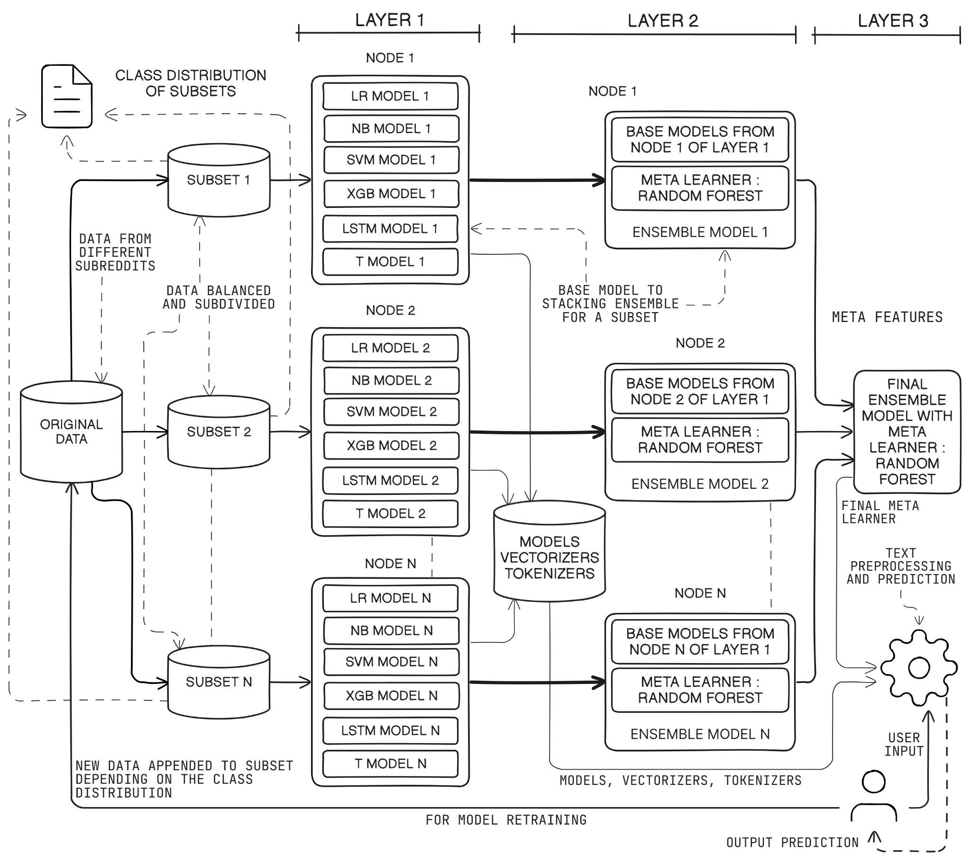
FUTURE SCOPE (CONTINUED)
(CONTINUED)
GR29 MULTIMODAL AI FRAMEWORK FOR SOCIAL MEDIA BASED MENTAL DISORDER DETECTION AND PERSONALIZED WELLBEING INSIGHTS
ARCHITECTURE 1 , WHERE FINAL ENSEMBLE MODEL IS BASED ON N INTERMEDIATE ENSEMBLE MODELS FROM N SUBSETS
JUNE 2025
@DEPT. OF CSE, TMSL

Slide 42
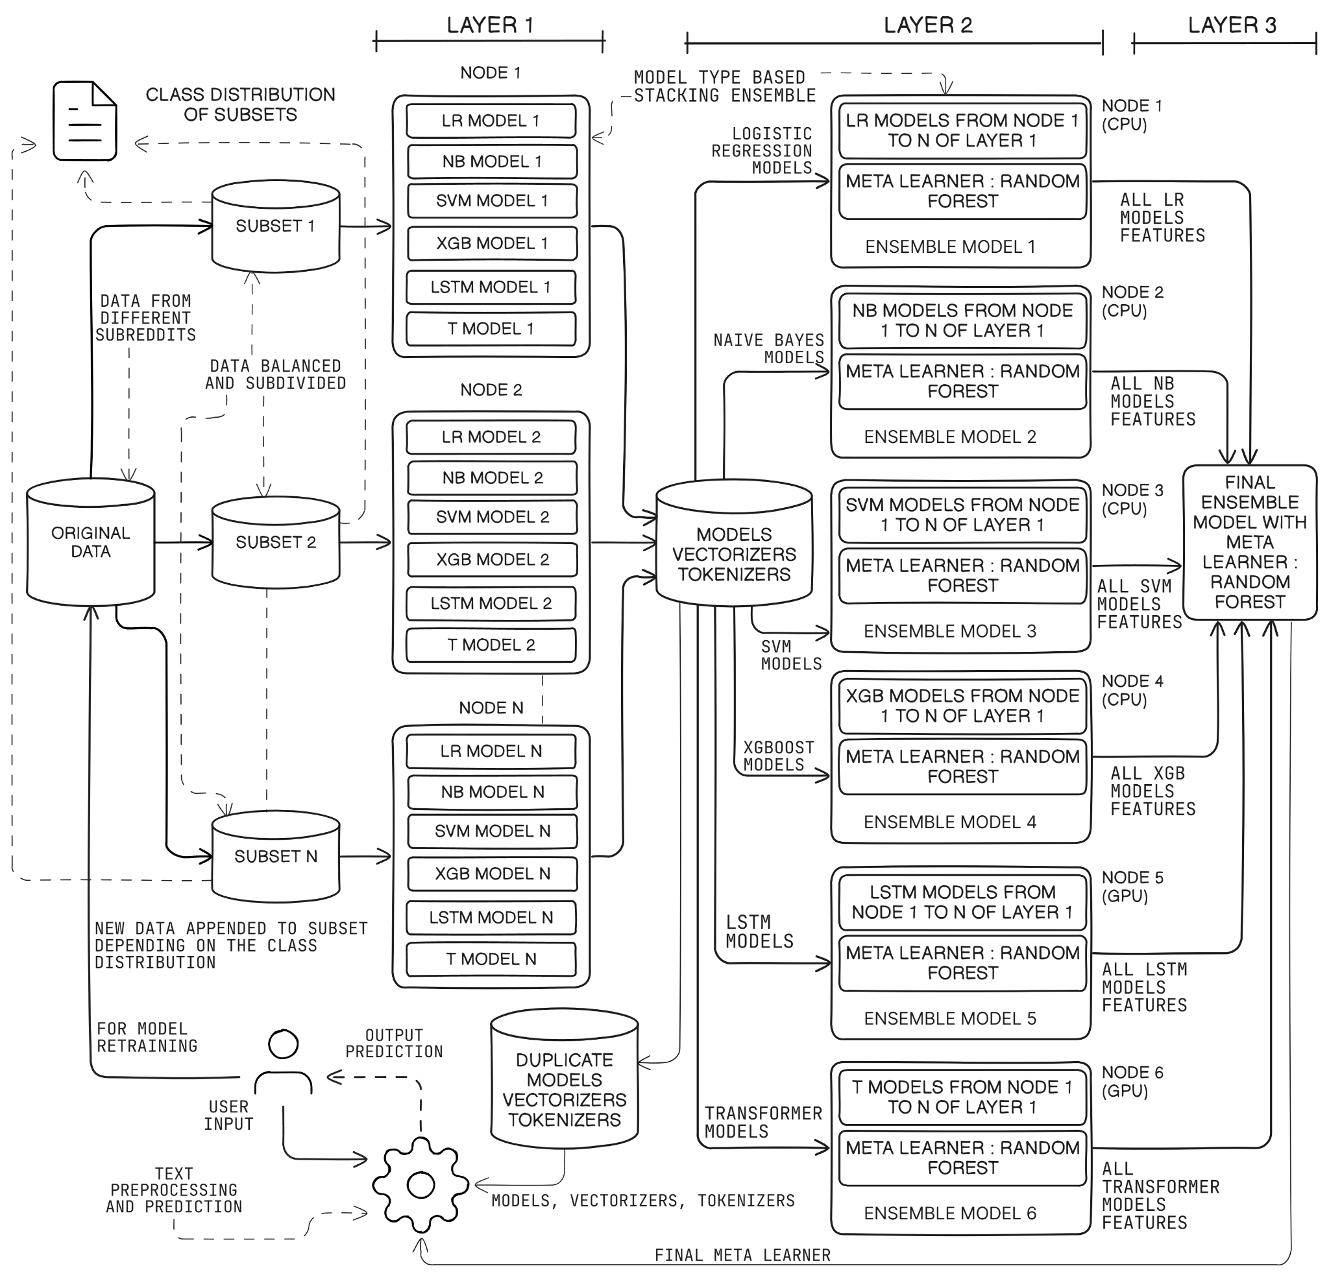
FUTURE SCOPE (CONTINUED)
GR29 MULTIMODAL AI FRAMEWORK FOR SOCIAL MEDIA BASED MENTAL DISORDER DETECTION AND PERSONALIZED WELLBEING INSIGHTS
ARCHITECTURE 2 , WHERE FINAL ENSEMBLE MODEL IS BASED ON 6 INTERMEDIATE ENSEMBLE MODELS FROM N SUBSETS
JUNE 2025
@DEPT. OF CSE, TMSL

Slide 43
REFERENCES
GR29 MULTIMODAL AI FRAMEWORK FOR SOCIAL MEDIA BASED MENTAL DISORDER DETECTION AND PERSONALIZED WELLBEING INSIGHTS
Choudhury, M. D., De, S., & Counts, S. (2013). Predicting Depression via Social Media. Proceedings of the 7th International Conference on Weblogs and Social Media.
Guntuku, S. C., Bollen, J., & Lazer, D. (2017). Detecting Mental Illness in Social Media. American Journal of Public Health, 107(8), 1279-1285.
Mathur, P., Kharat, M., & Patil, S. (2022). Machine Learning Approaches for Mental Health Detection on Social Media: A Systematic Review. IEEE Access, 10, 14376-14388.
Nadeem, A. (2016). A Study of Depression Identification on Twitter. International Journal of Computer Applications, 141(10), 24-28.
AlSagri, A., & Ykhlef, M. (2020). A Machine Learning-based Approach for Depression Detection in Social Media. Journal of King Saud University - Computer and Information Sciences, 32(1), 60-66.
Vaishnavi, A., Rani, A., & Narayan, M. (2022). Application of Machine Learning Algorithms for Mental Health Prediction. International Journal of Data Science and Analytics, 12(2), 175-192.
Safa, M., Alshahrani, S., & Abunadi, M. (2023). Ethical Considerations in Predicting Mental Health from Social Media: A Roadmap for Future Research. Ethics and Information Technology, 25(1), 15-29.
JUNE 2025
@DEPT. OF CSE, TMSL

Slide 44
REFERENCES (CONTINUED)
GR29 MULTIMODAL AI FRAMEWORK FOR SOCIAL MEDIA BASED MENTAL DISORDER DETECTION AND PERSONALIZED WELLBEING INSIGHTS
Single classifier vs. ensemble machine learning approaches for mental health prediction by Dip Kumar Saha, Tuhin Hossain, Mejdl Safran, Sultan Al Farhood, M. F. Mridha, and Dunren Che demonstrates that Gradient Boosting (88.80%) and Neural Networks (88.00%) outperform ensemble models (85.60%) for mental health issue prediction, based on survey data from OSMI.
Ensemble of hybrid model-based technique for early detection of depression by Konda Vaishnavi, U Nikitha Kamath, B Ashwath Rao, and N V Subba Reddy introduces a hybrid SVM-MLP model with SMOTE for class balancing, achieving 99.39% accuracy and 99.51% F1-score, highlighting its efficacy in early depression detection.
Survey of transformers and towards ensemble learning using transformers for NLP by Hongzhi Zhang and M.Omair Shafiq reviews transformer models and explores ensemble learning with transformers, showcasing their superior performance in NLP tasks like sentiment analysis and text generation.
JUNE 2025
@DEPT. OF CSE, TMSL

Slide 45
GR29 MULTIMODAL AI FRAMEWORK FOR SOCIAL MEDIA BASED MENTAL DISORDER DETECTION AND PERSONALIZED WELLBEING INSIGHTS
THANK YOU
JUNE 2025
@DEPT. OF CSE, TMSL

